Slide 1
Deep Learning for Vision I
Presented by Ranga Rodrigo
Slides are from the sources particularly from Justin Johnson, Derek Hoiem and Svetlana Lazebnik.

Slide 2

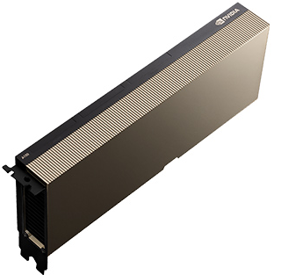
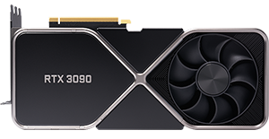





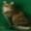
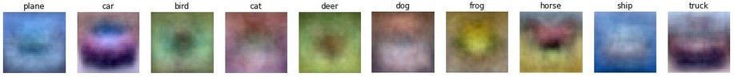
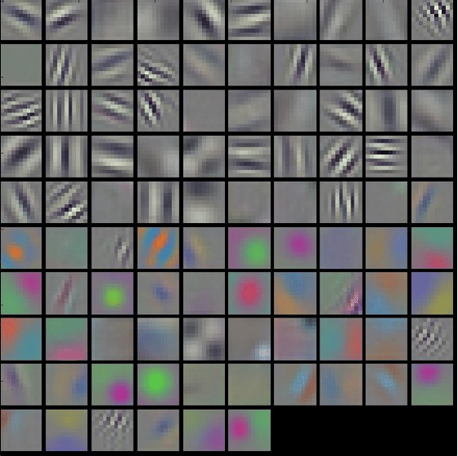
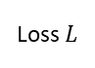

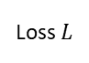

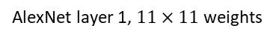
WHAT IS DEEP LEARNING
WHY NOW
Deep learning is a machine learning advancement that allows the system to automatically discover (learn) representations (representation learning) using a stack of multiple (deep) layers (of neurons, a neural network).
Research → industry
Computation power
AL
ML
NN
DNN
Artificial intelligence
Machine learning
Intel i9
Nvidia RTX 3090
Nvidia A100
Neural networks
Deep neural networks
Images
Feature Extractor
Classifier $f$
Loss $L$
Labels
Training
Images
Neural Network $f$
Loss $L$
Labels
Training
Linear classifier: Learnt filters
https://cs231n.github.io/linear-classify/
https://www.nvidia.com/en-us/data-center/a100/
https://www.nvidia.com/en-us/geforce/graphics-cards/30-series/rtx-3090/
https://www.intel.com/content/www/us/en/products/details/processors/core/x.html
AlexNet layer 1, $11×11$weights

Slide 3











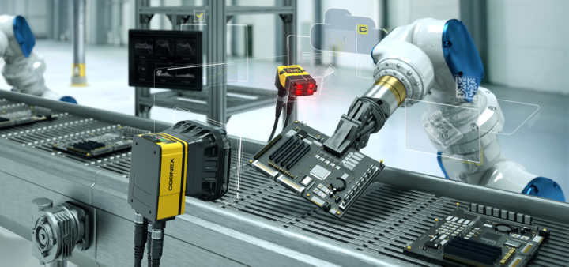
SENSORS AND CAMERAS
PROCESSING, ANALYSIS
DECISIONS, ACTUATION
Cameras
COMMUNICATION
DEEP LEARNING APPLICATIONS IN MANUFACTURING
Vision based image classification
Vision based object detection
Vision based defect or anomaly detection
Vision based metrology
Time-series analysis for monitoring equipment
DEEP LEARNING APPLICATIONS IN OTHER DOMAINS
Self driving
Surveillance
Computer graphics
Natural language processing
https://www.cognex.com/what-is/industry-4-0-machine-vision

Slide 4
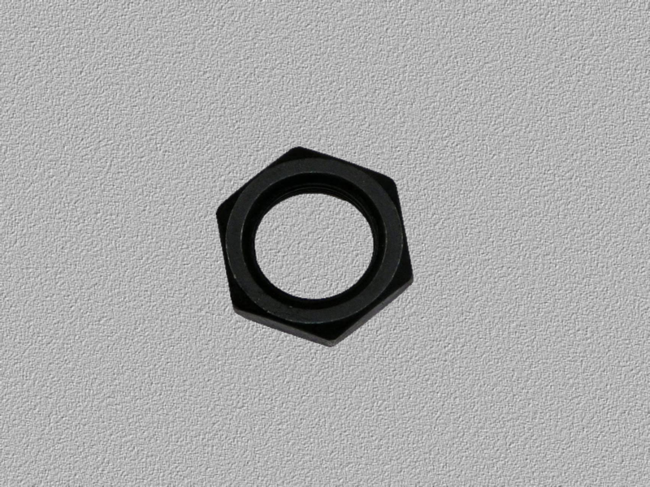
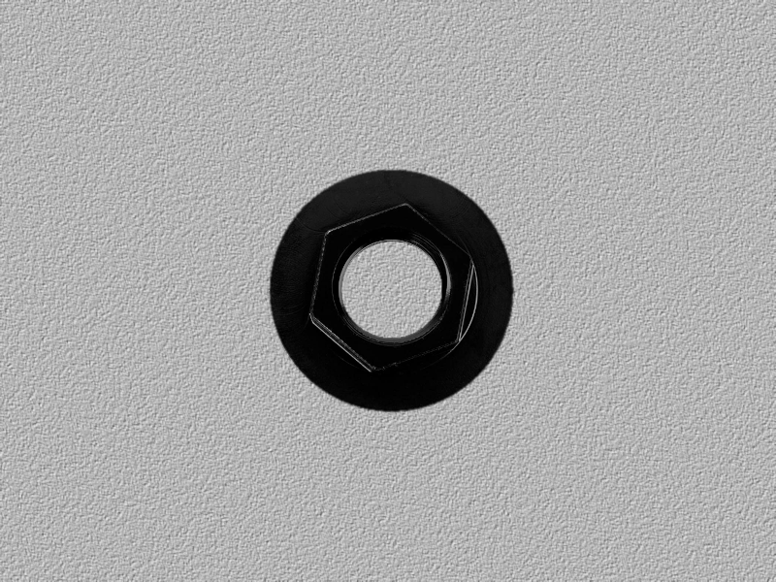

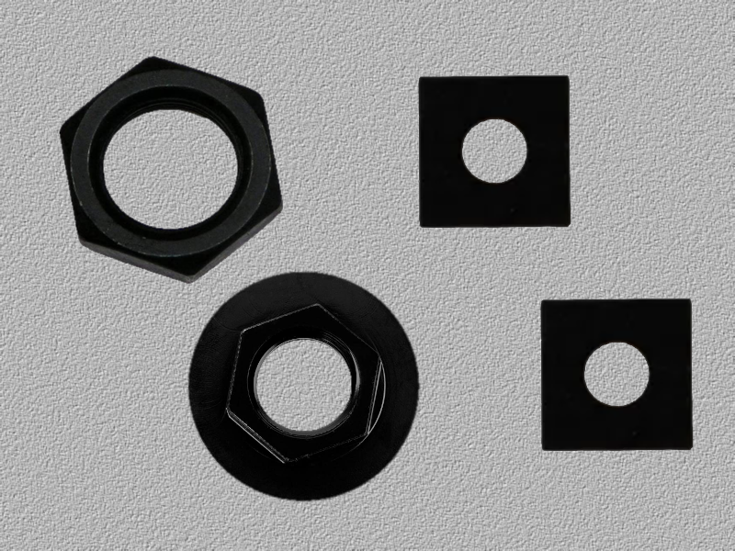
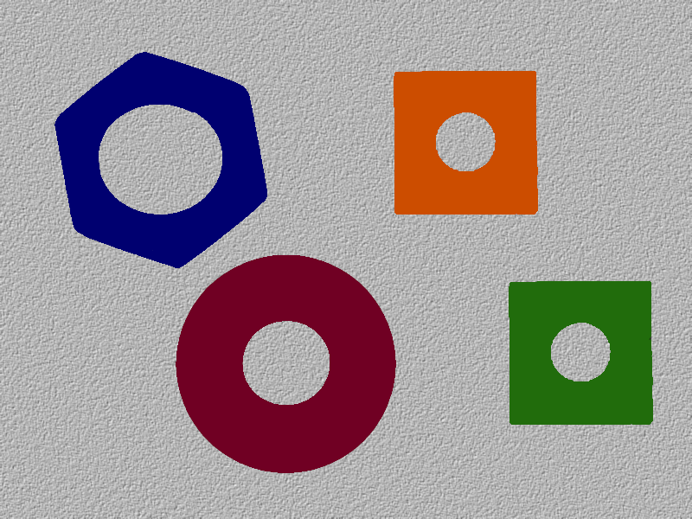
OTHER TASKS
Sematic segmentation
Panoptic segmentation
CLASSIFICATION
Examples in MVTec
https://www.mvtec.com/products/deep-learning-tool
hex-nut
flanged hex-nut
square nut
hex nut 0.8
sq. nut 0.9
hex nut 1
sq. nut 1
flanged hex 0.7
OBJECT DETECTION
INSTANCE SEGMENTATION
sq. nut 0.8
flanged hex 1
sq. nut 2

Slide 5
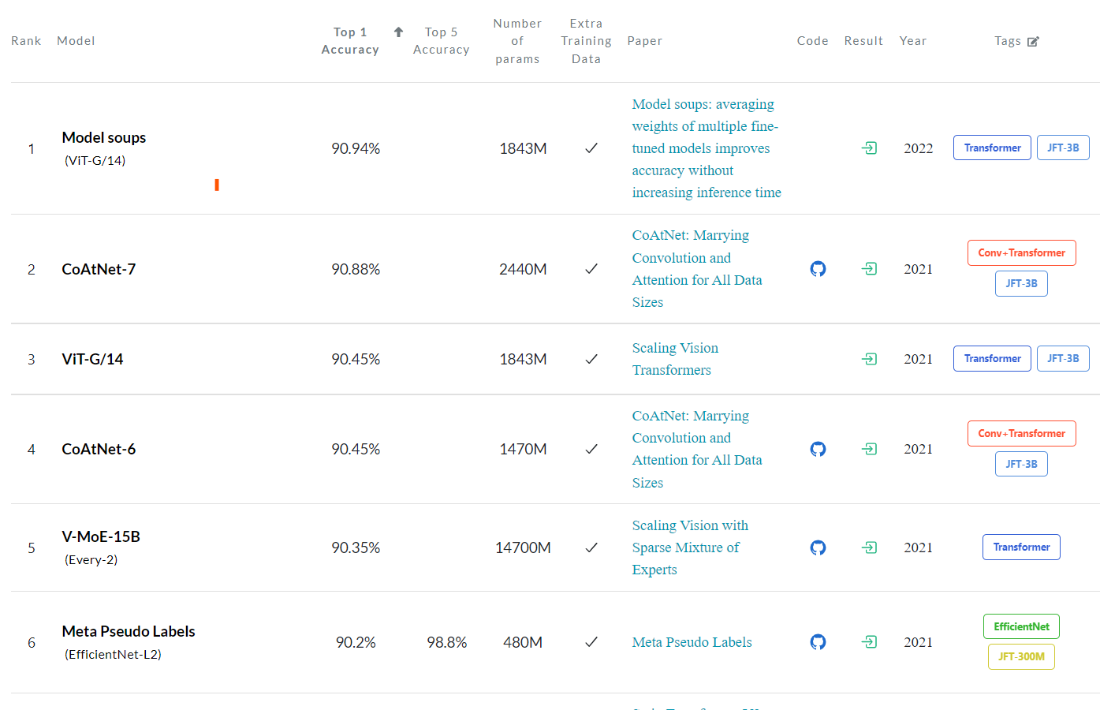
Image Classification on ImageNet
https://paperswithcode.com/sota/image-classification-on-imagenet

Slide 6
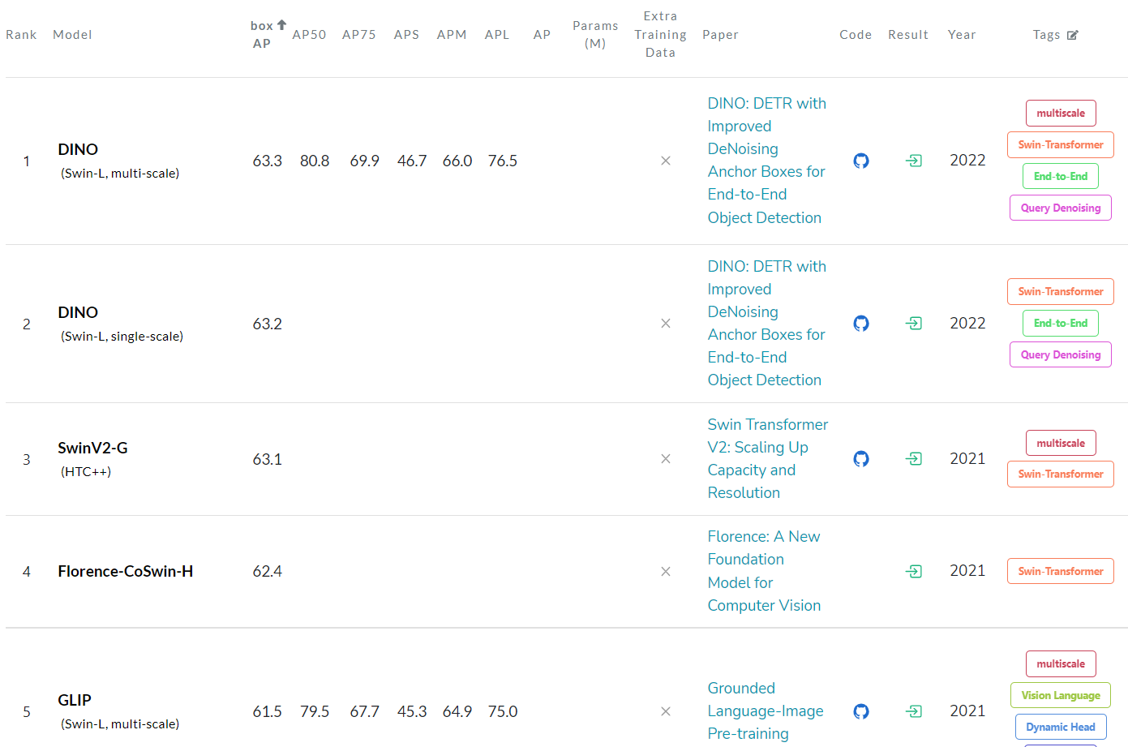
Object Detection on COCO test-dev
https://paperswithcode.com/sota/object-detection-on-coco

Slide 7
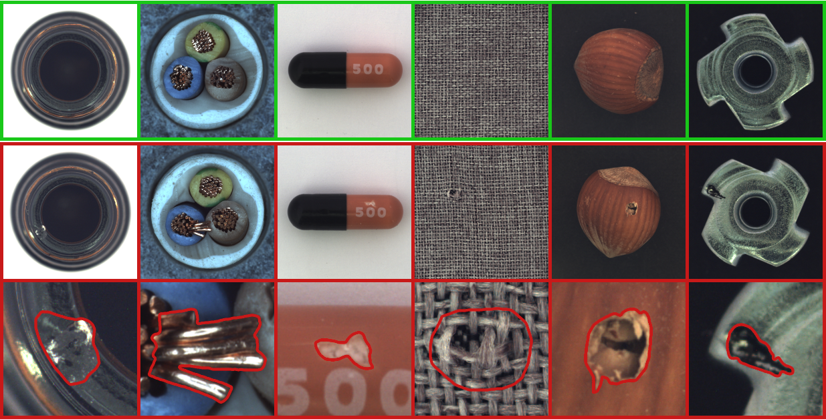
ANOMALY DETECTION
https://www.mvtec.com/company/research/datasets/mvtec-ad, https://www.youtube.com/watch?v=uHIAs0xYzhs
Notes:
This is form MVTECH anomaly detection database. Top row show the good pictures. The middle row shows the image-wise classification. The third row shows segmentation of anomalous region. These are now done by training a generative adversarial network on good images, so that when an image with an anomaly is presented, the generated image is without the anomaly. We can detect the anomalous area by finding the difference.

Slide 8
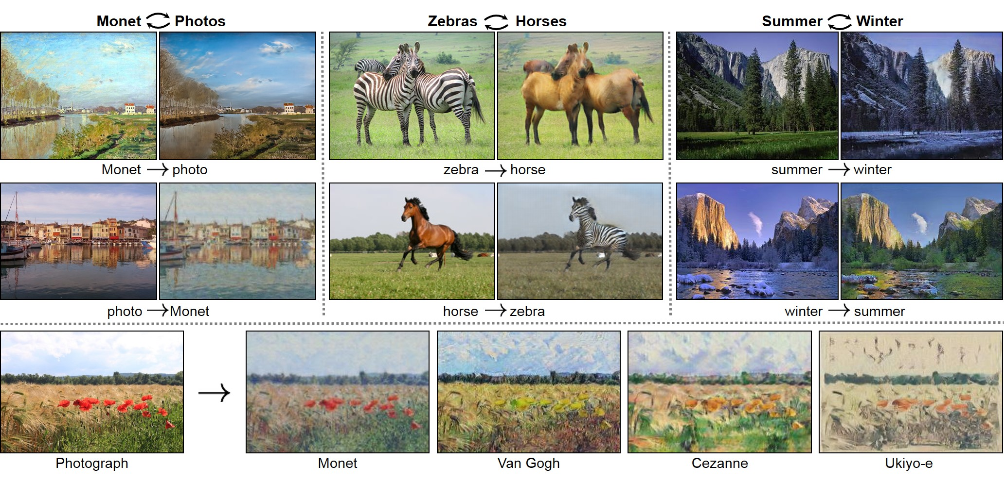
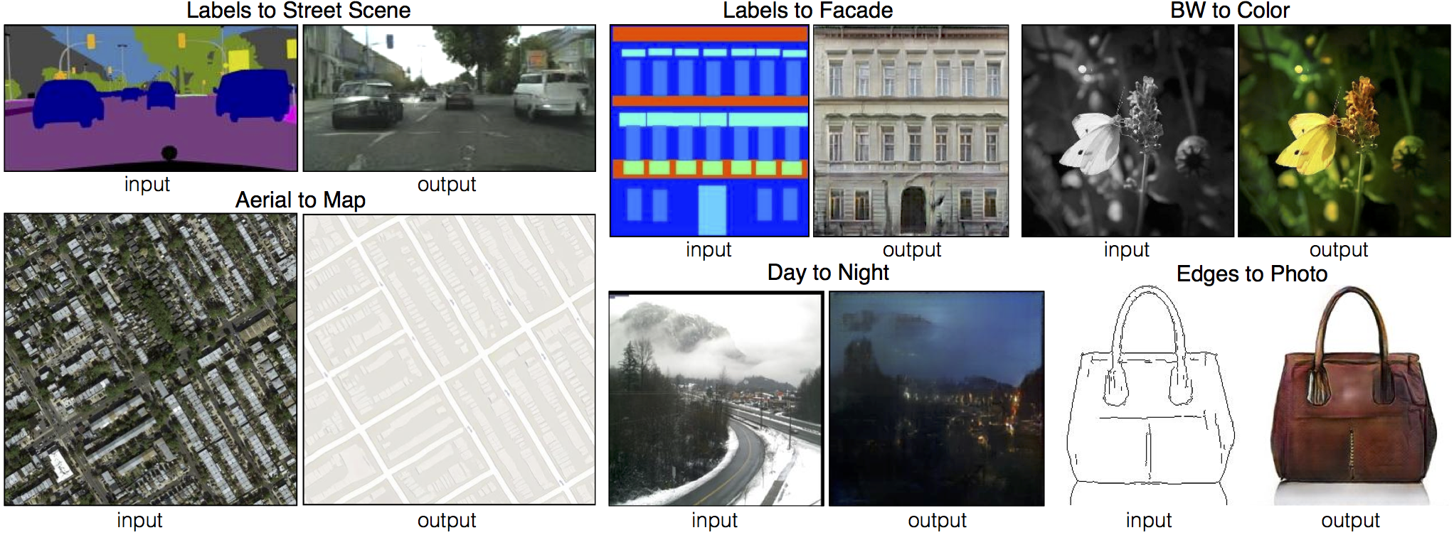
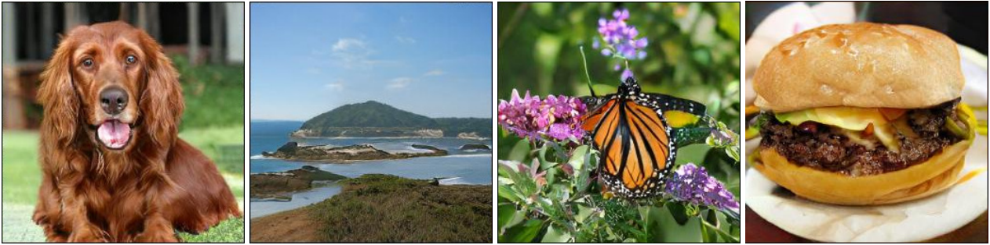
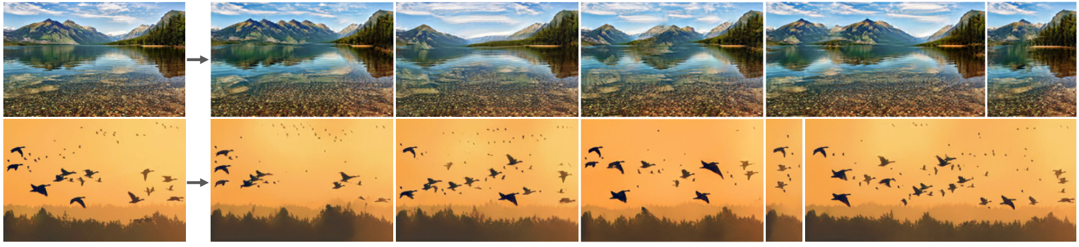
SYNTHESIS
pix2Pix: Isola et al., Image-to-Image Translation with Conditional Adversarial Nets, CAPR2017
CycleGAN: Zhu et al., Unpaired Image-to-Image Translation using Cycle-Consistent Adversarial Networks, IUCCV2017
Brock et al, Large Scale GAN Training for High Fidelity Natural Image Synthesis, ICLR2019.
Saham et al., SinGAN: Learning a Generative Model from a Single Natural Image, ICCV2019
Notes:
Pix2Pix: conditional adversarial networks as a general-purpose solution to image-to-image translation problems. These networks not only learn the mapping from input image to output image, but also learn a loss function to train this mapping. This makes it possible to apply the same generic approach to problems that traditionally would require very different loss formulations.
CycleGAN: Image-to-image translation is a class of vision and graphics problems where the goal is to learn the mapping between an input image and an output image using a training set of aligned image pairs. However, for many tasks, paired training data will not be available. We present an approach for learning to translate an image from a source domain X to a target domain Y in the absence of paired examples.
SinGAN: We introduce SinGAN, an unconditional generative model that can be learned from a single natural image. Our model is trained to capture the internal distribution of patches within the image, and is then able to generate high quality, diverse samples that carry the same visual content as the image. SinGAN contains a pyramid of fully convolutional GANs, each responsible for learning the patch distribution at a different scale of the image. This allows generating new samples of arbitrary size and aspect ratio, that have significant variability, yet maintain both the global structure and the fine textures of the training image. In contrast to previous single image GAN schemes, our approach is not limited to texture images, and is not conditional (i.e. it generates samples from noise). User studies confirm that the generated samples are commonly confused to be real images. We illustrate the utility of SinGAN in a wide range of image manipulation tasks.
BIgGAN: Despite recent progress in generative image modeling, successfully generating high-resolution, diverse samples from complex datasets such as ImageNet remains an elusive goal. To this end, we train Generative Adversarial Networks at the largest scale yet attempted, and study the instabilities specific to such scale. We find that applying orthogonal regularization to the generator renders it amenable to a simple "truncation trick," allowing fine control over the trade-off between sample fidelity and variety by reducing the variance of the Generator's input. Our modifications lead to models which set the new state of the art in class-conditional image synthesis. When trained on ImageNet at 128x128 resolution, our models (BigGANs) achieve an Inception Score (IS) of 166.5 and Frechet Inception Distance (FID) of 7.4, improving over the previous best IS of 52.52 and FID of 18.6.

Slide 9

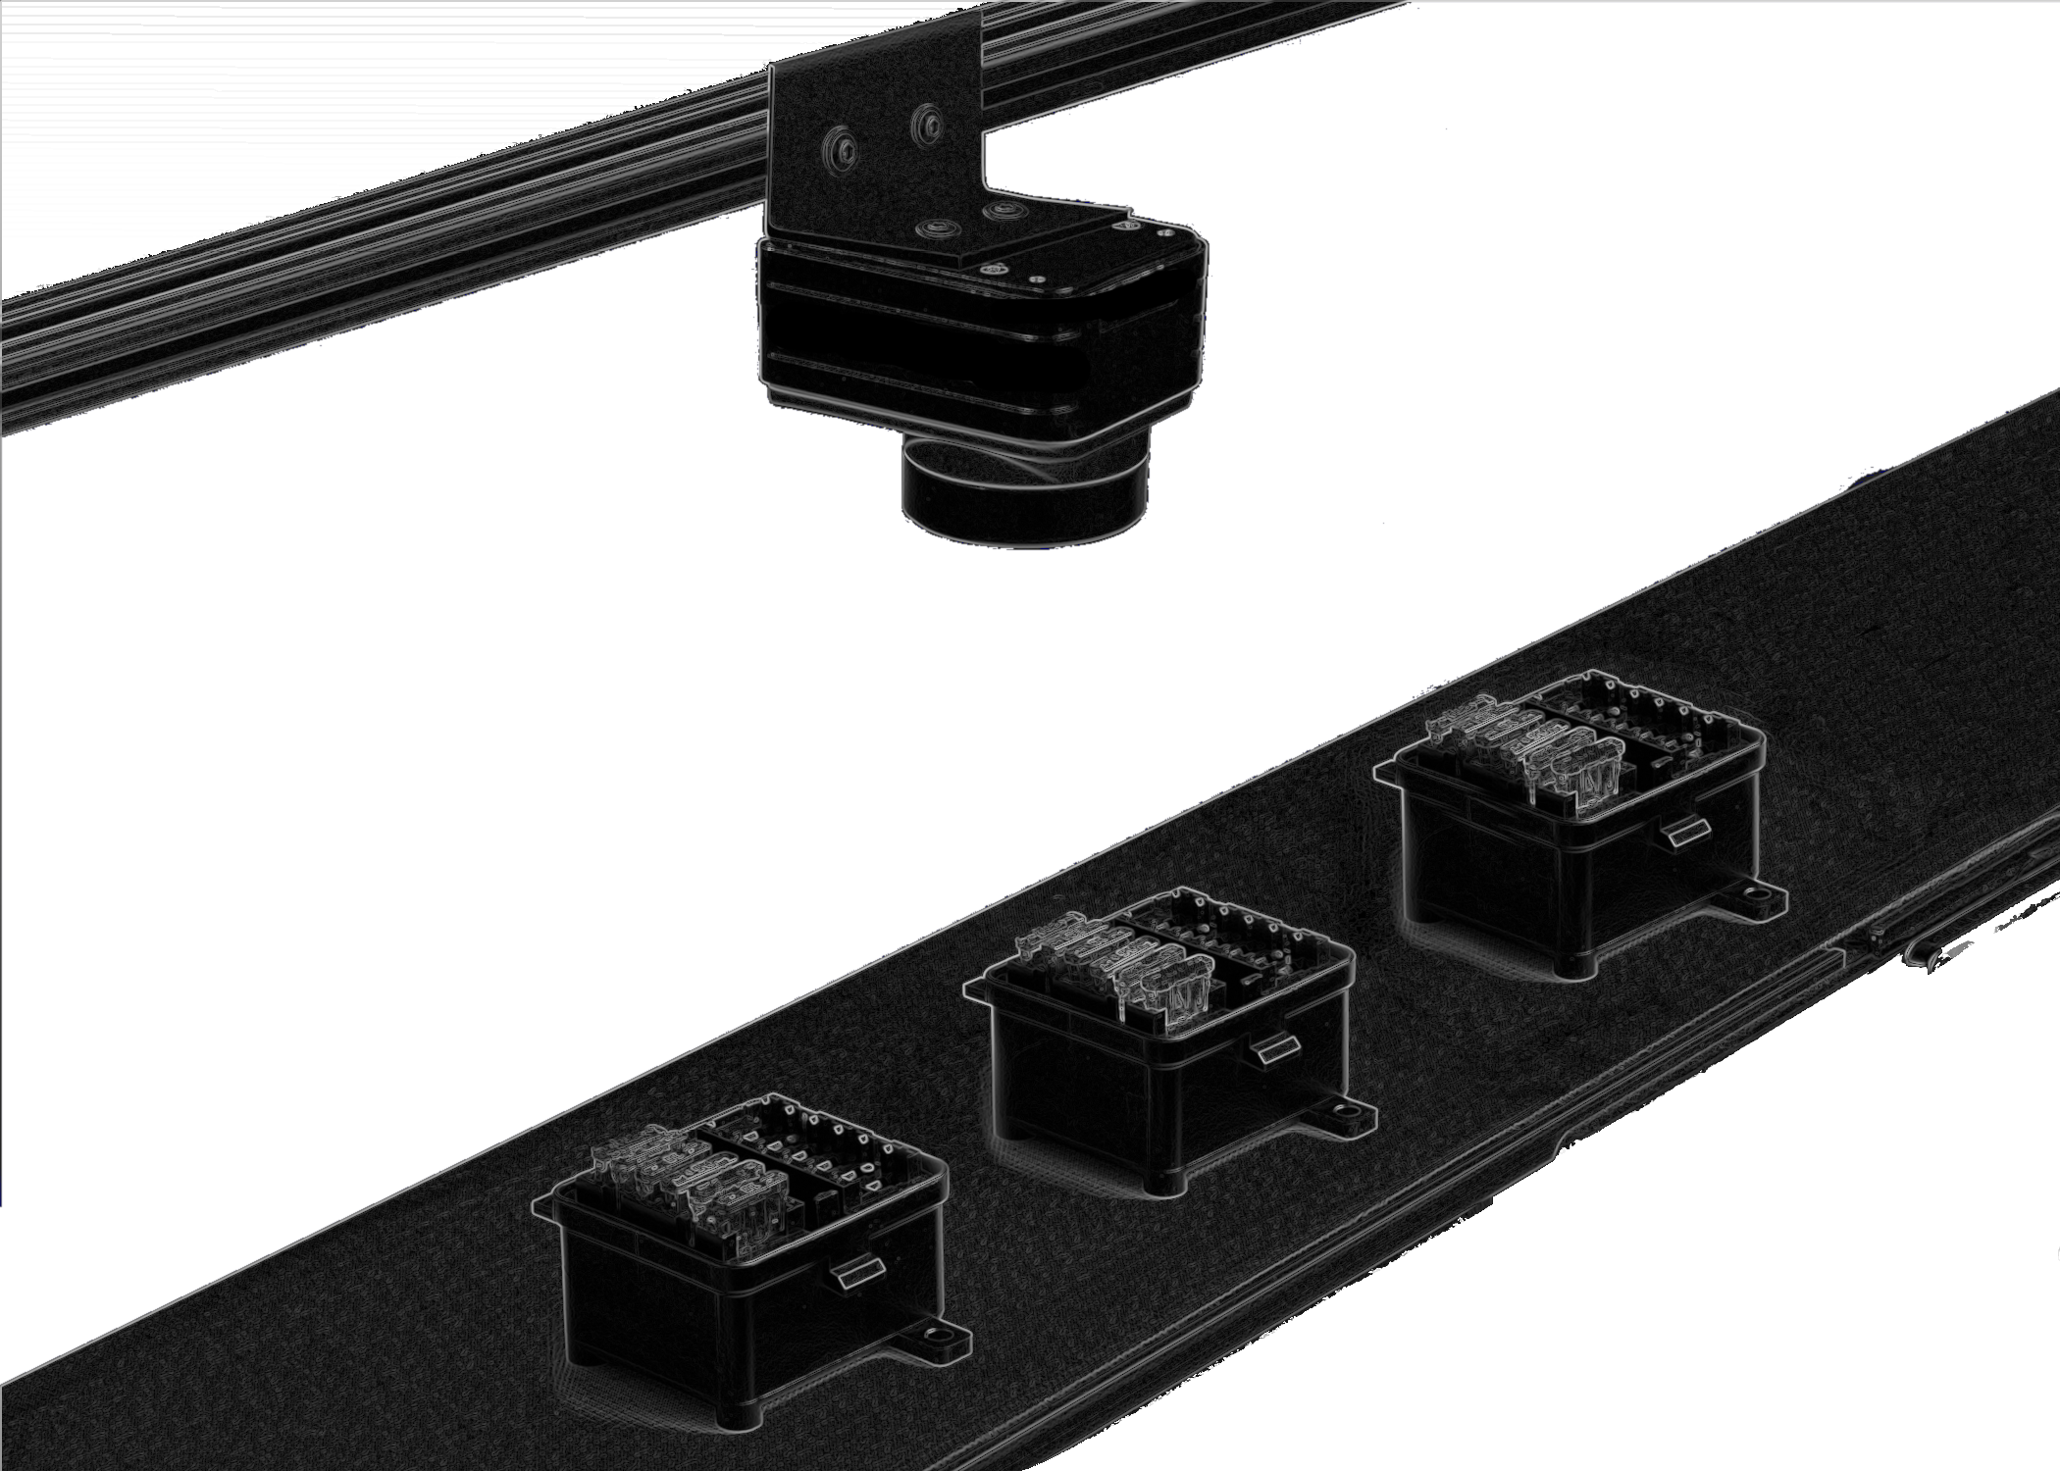




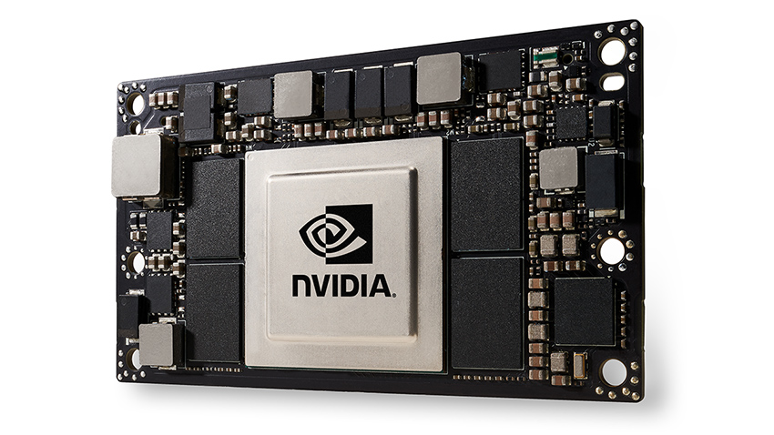
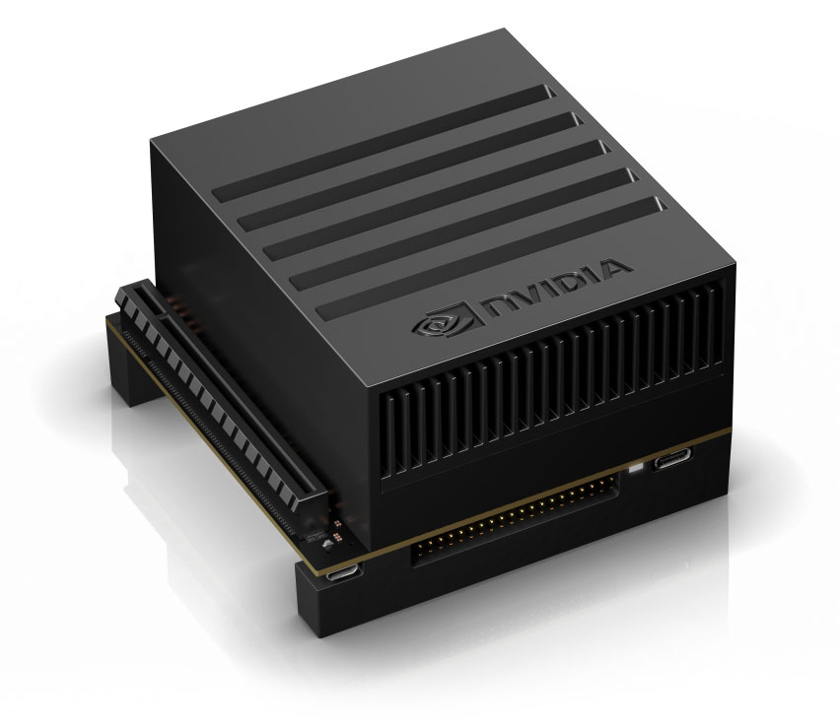

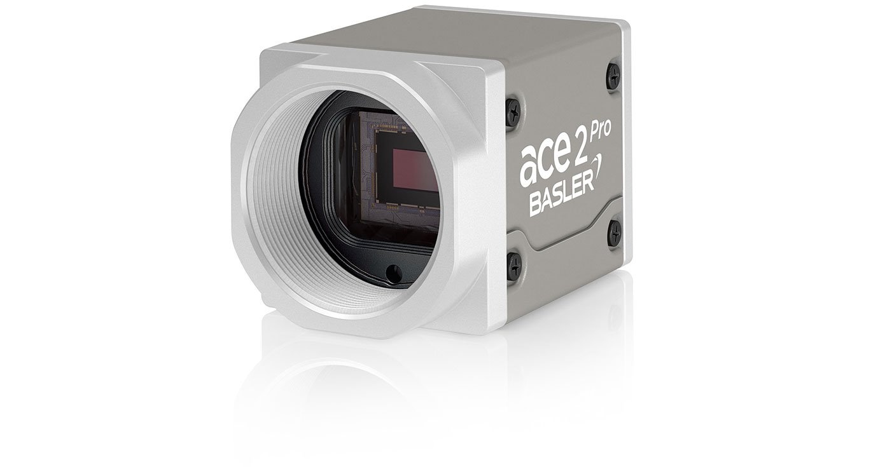
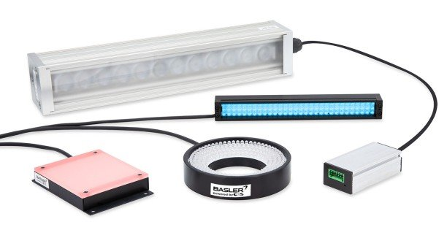

PROCESS
PREPARATION
TRAINING
VALIDATION
INFERNCE
COMMUNICATION
M2M, actuation or actionable insights
HARDWARE
Good cameras and lenses: E.g., Basler, Cognex, FLIR
Lighting and imaging setup
JETSON TX2
Jetson AGX Xavier
Processing hardware (training, inference): GPUs (see slide 2), specialized boards (e.g., Jetson), or cloud
Example Basler Camera
Example Basler Lighting
https://www.youtube.com/watch?v=uHIAs0xYzhs, https://icon-library.com/
https://www.cognex.com/what-is/machine-vision/components/lighting, https://www.baslerweb.com/en/products/vision-components/basler-lighting/
Notes:
The process involved typically consts of obtaining images and preparation. After images have been acquired (i.e., prepared) the system must be trained. Then parameters tuning happens in the validation stage. Inference is making decisions on unseen images.

Slide 10
History of Deep Convolution Networks
1950s: neural nets (perceptron) invented by Rosenblatt
1980s - 1990s: Neural nets are popularized and then abandoned as being interesting idea but impossible to optimize or “unprincipled”
1990s: LeCun achieves state-of-art performance on character recognition with convolutional network (main ideas of today’s networks)
2000s: Hinton, Bottou, Bengio, LeCun, Ng, and others keep trying stuff with deep networks but without much traction/acclaim in vision
2010-2011: Substantial progress in some areas, but vision community still unconvinced
Some neural net researchers get ANGRY at being ignored/rejected
2012: shock at ECCV 2012 with ImageNet challenge
Slide: Derek Hoiem
Notes:
Rosenblatt: one-layer neural network.
Bishop wrote a book.
Large amounts of data.
After LeCun: Not so much labeled data was available.
2012 Image net challenge.

Slide 11
Prior to CNNs

Slide 12
Image Classification
Color histograms: throw out spatial information.
Histograms of Oriented Gradients (HOG): uses spatial information, however, they are templates of gradient.
Bags of Visual Words (BoVW): data-driven.
We can concatenate features representations to get a long high-dimensional vector.
Feature extractor and learnable model are distinct: only the last learnable part tunes itself to classify
Deep learning: single end-to-end pipeline.
A two-layer NN seems to compute features in the first layer and used them to classify inputs in the second layer.

Slide 13
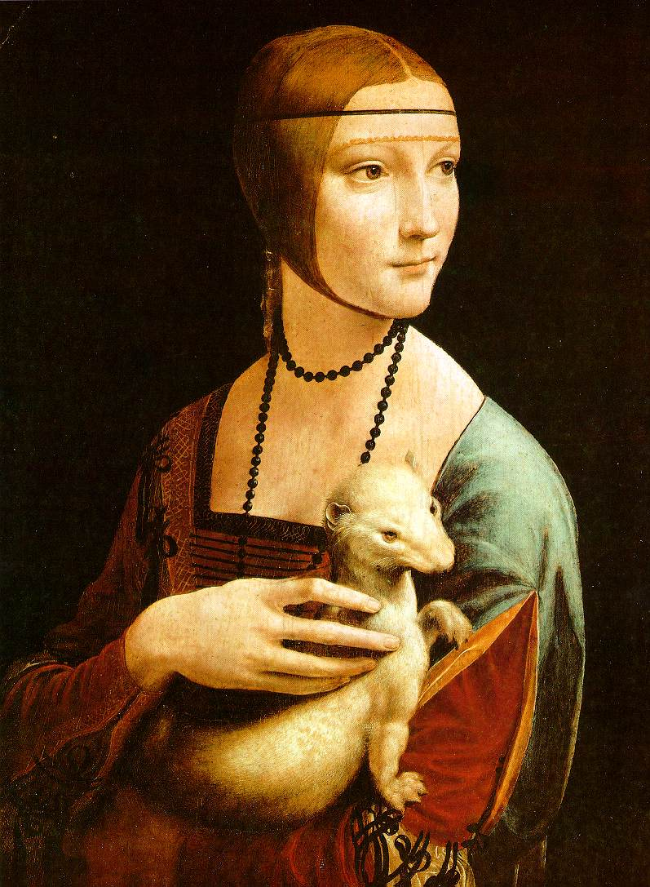
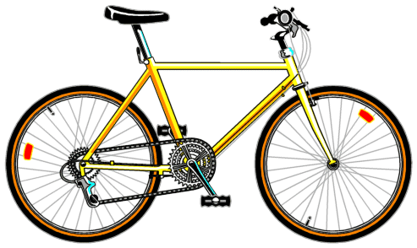
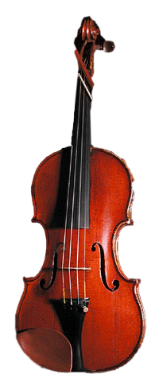
Classification: Bag of Visual Words Features
Extract local features
Learn “visual vocabulary”
Quantize local features using visual vocabulary
Represent images by frequencies of “visual words”
Train a classifier (kNN, linear, SVM)
Notes:
Classification means to assign a label per image. This uses the ImageNet, a large-scale labeled image database. Classification task prior to deep learning was based on BoVW. Features were hand-crafted features like SIFT features.

Slide 14
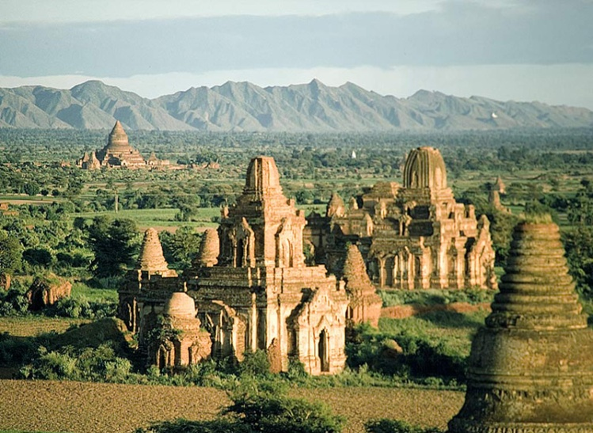
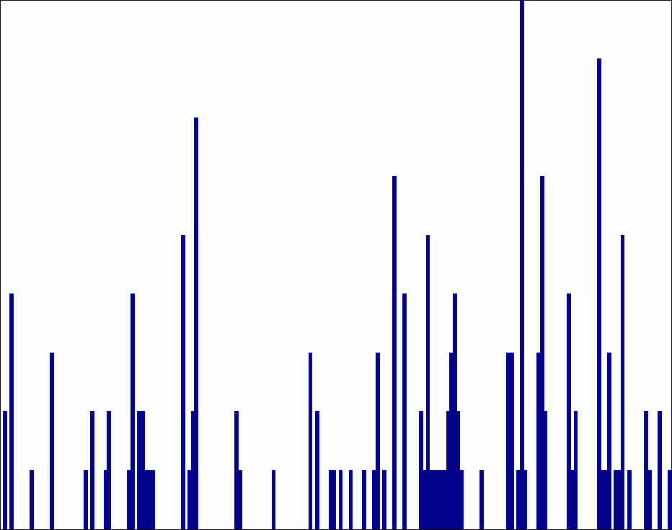
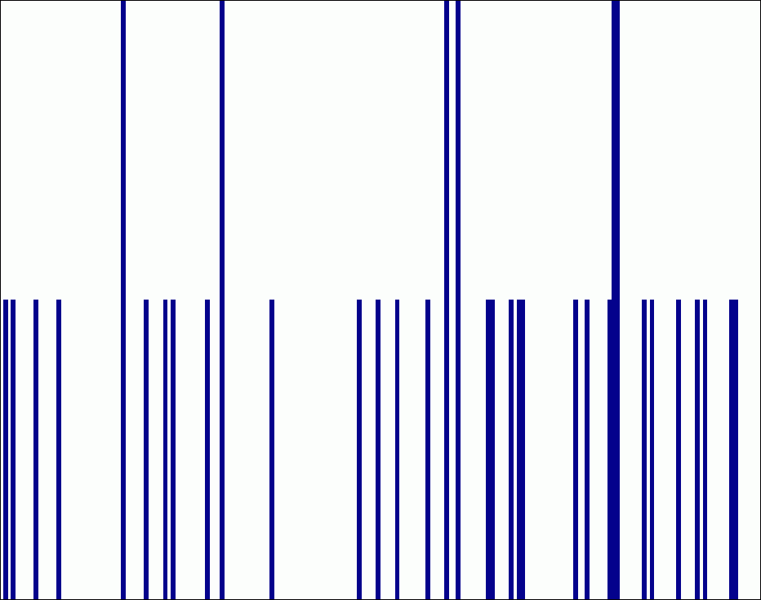



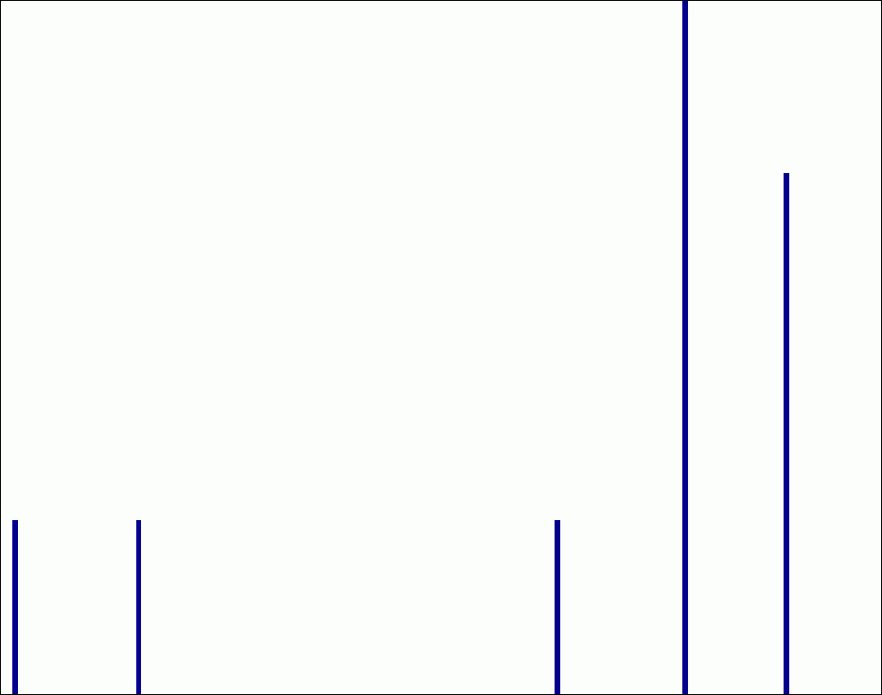
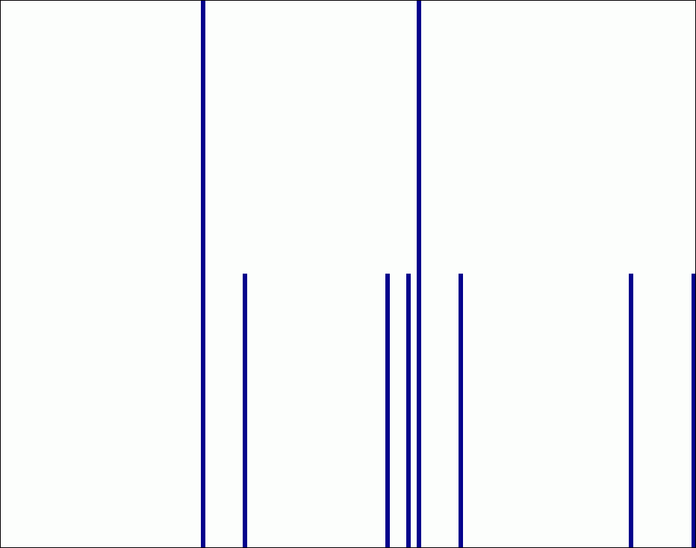
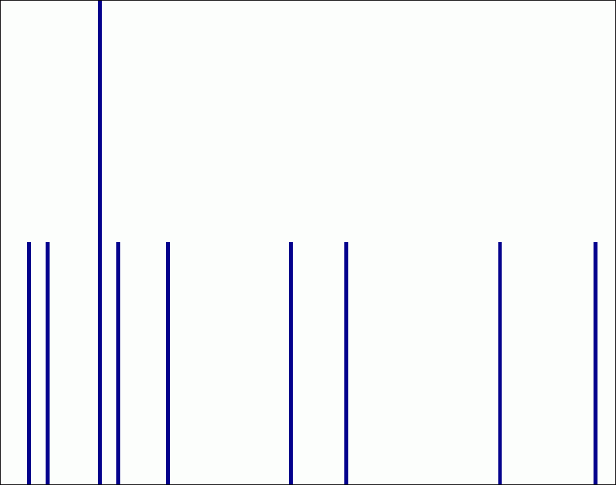
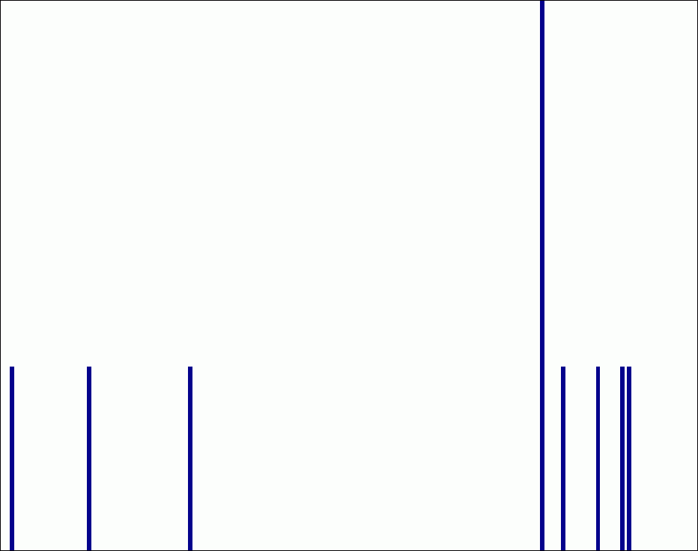

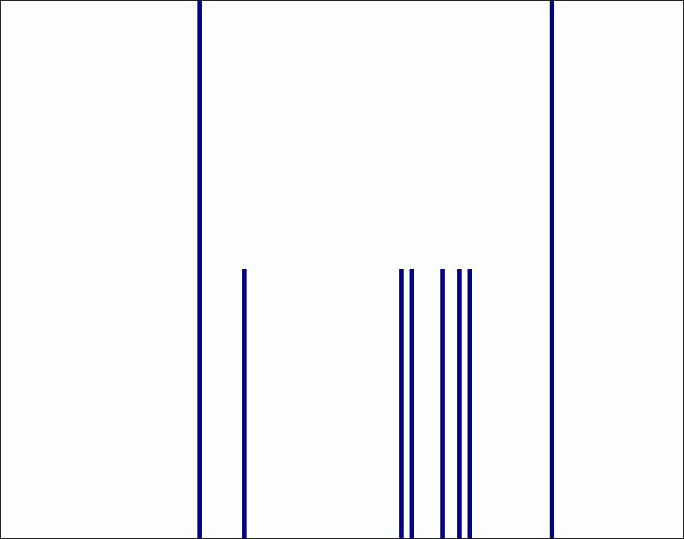
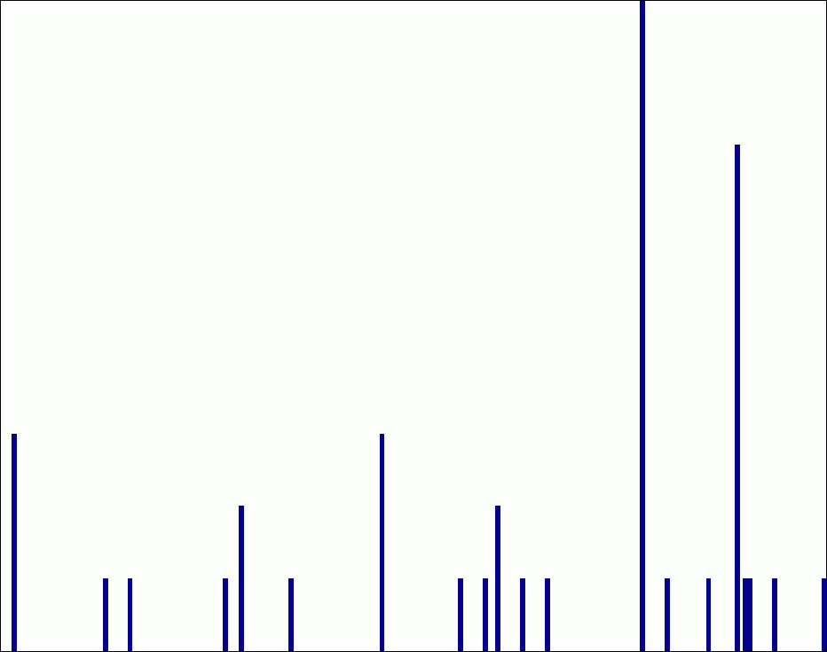
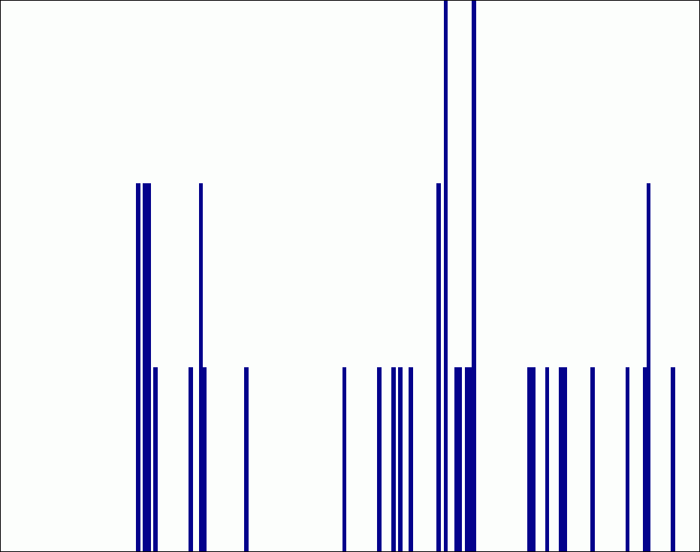

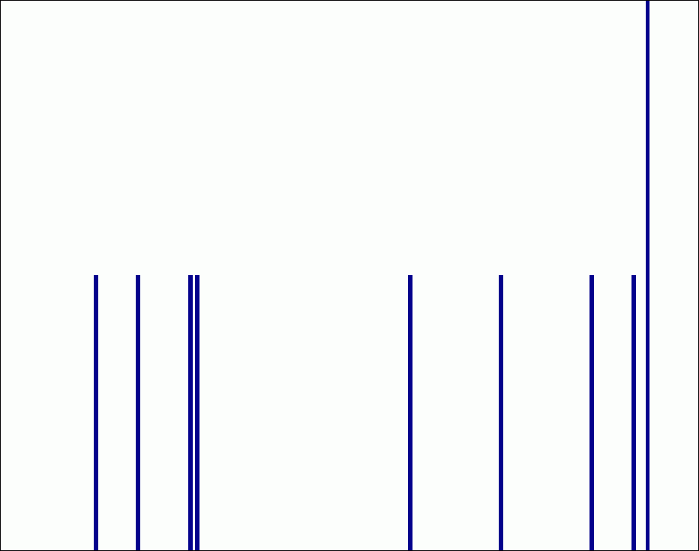

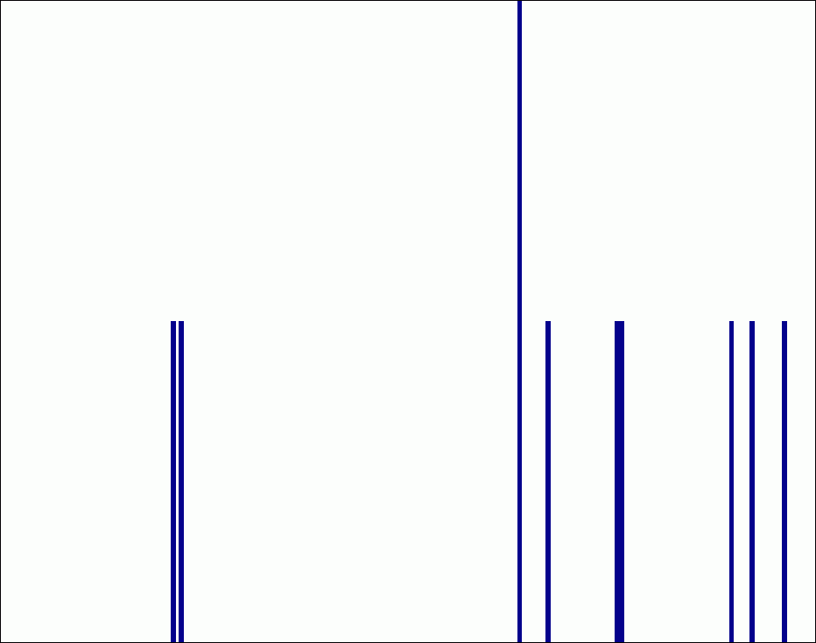

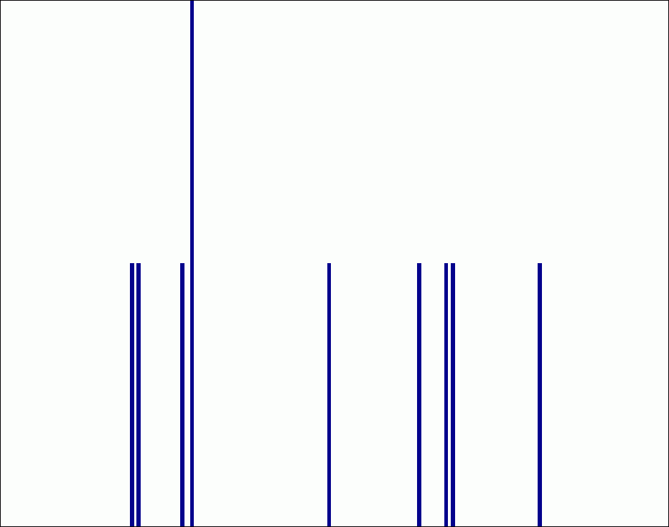
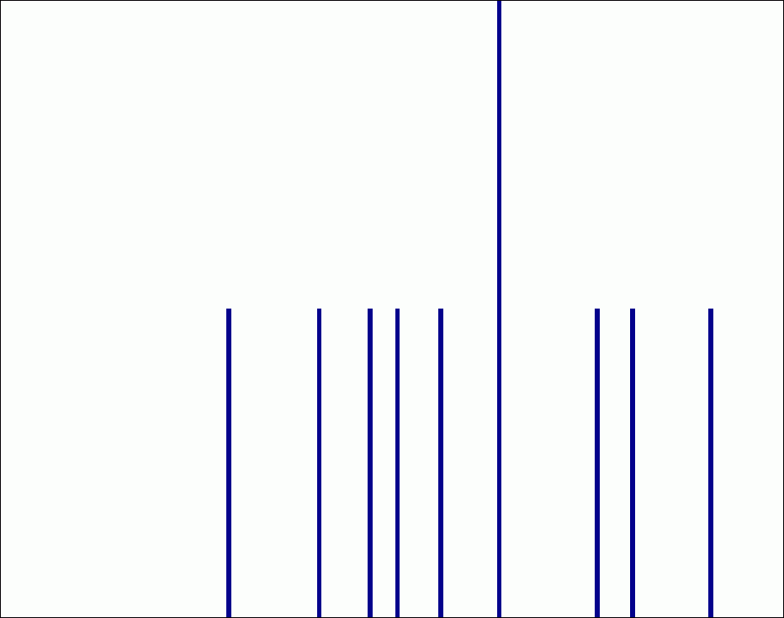
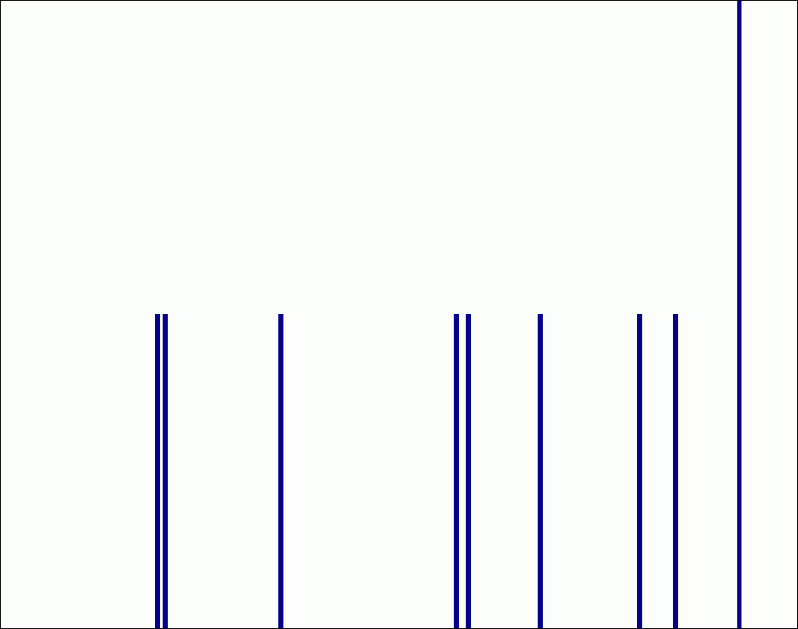
Spatial Pyramids
level 0
level 1
level 2
Lazebnik, Schmid & Ponce (CVPR 2006)

Slide 15
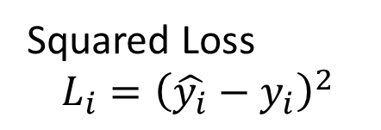
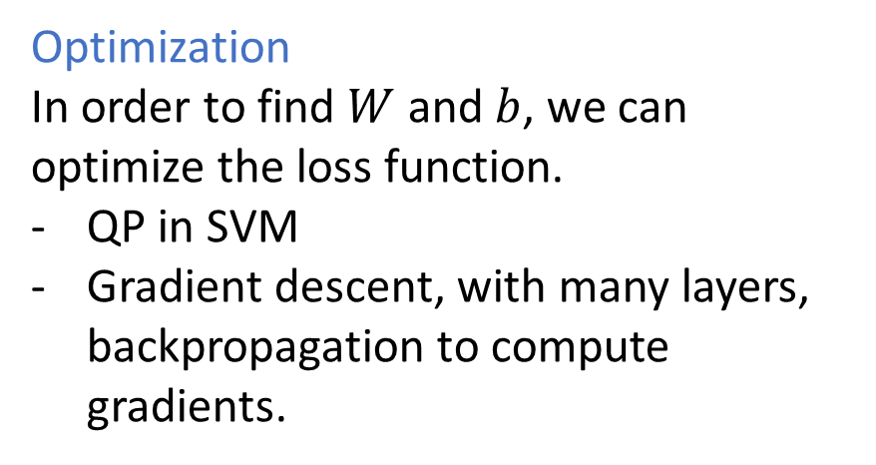
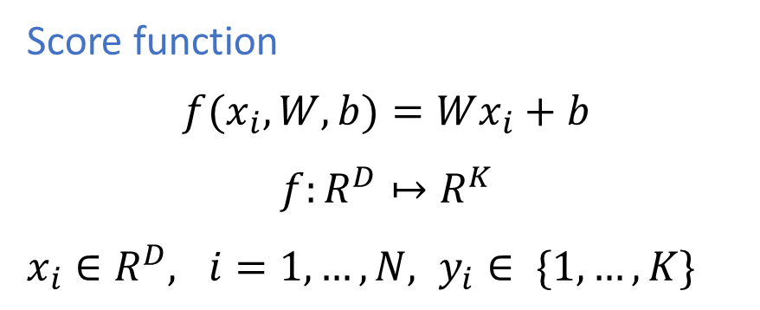
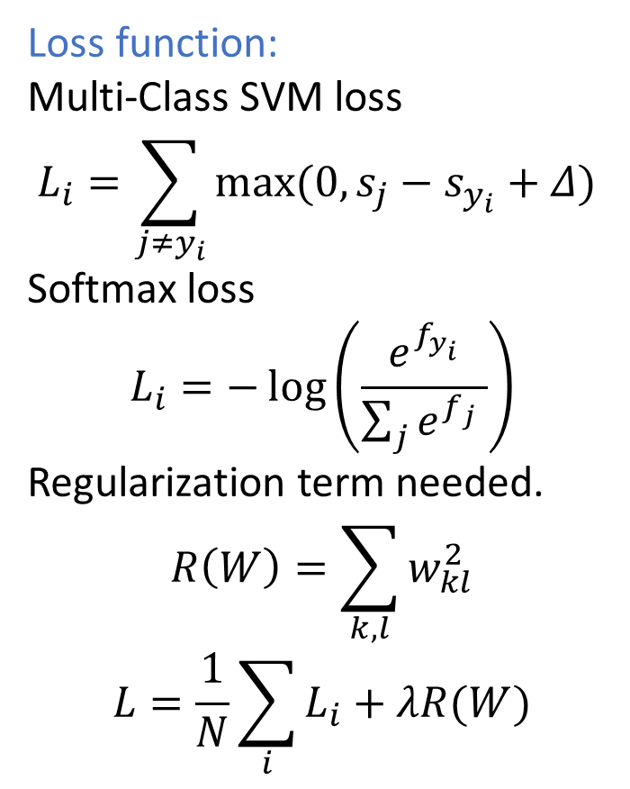
Linear Classification
We must define a score function, and a loss function.
Score function
$$f(x_{i},W,b)=Wx_{i}+b$$
$$f:R^{D}↦R^{K}$$
$x_{i}∈R^{D}, i=1, …, N, y_{i}∈ \{1, …, K\}$
Loss function:
Multi-Class SVM loss
$$L_{i}=\sum_{j≠y_{i}}{max(0,s_{j}−s_{y_{i}}+Δ) }$$
Softmax loss
$$L_{i}=−\log\left(\frac{e^{f_{y_{i}}}}{\sum_{j}{e^{f_{j}} }}\right)$$
Regularization term needed.
$$R\left(W\right)=\sum_{k,l}{w_{kl}^{2}}$$
$$L=\frac{1}{N}\sum_{i}{L_{i}}+λR(W)$$
Squared Loss
$$L_{i}={\left(\hat{y_{i}}−y_{i}\right)}^{2}$$
Optimization
In order to find $W$ and $b$, we can optimize the loss function.
QP in SVM
Gradient descent, with many layers, backpropagation to compute gradients.
https://cs231n.github.io/linear-classify/
Notes:
The approach will have two major components: a score function that maps the raw data to class scores, and a loss function that quantifies the agreement between the predicted scores and the ground truth labels. The loss function measure the quality of the predictions. Then the loss function is to be minimized with respect to the parameters of the score function.
SVM loss: max(0,−) function is often called the hinge loss. the SVM loss function wants the score of the correct class yi to be larger than the incorrect class scores by at least by Δ (delta)

Slide 16
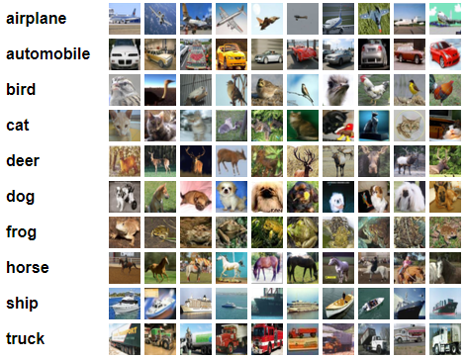
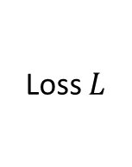
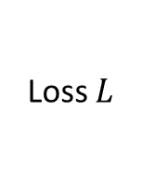


Classical Approach vs. Neural Networks
Images
Feature Extractor
Classifier $f$
Labels
Loss $L$
Training
Images
Neural network $f$
Labels
Loss $L$
Training

Slide 17

Linear Classifier
Example learned weights at the end of learning for CIFAR-10. Note that, for example, the ship template contains a lot of blue pixels as expected. This template will therefore give a high score once it is matched against images of ships on the ocean with an inner product.
https://cs231n.github.io/linear-classify/

Slide 18









The Perceptron
Perceptron is a linear classifier.
Capturing $b$ also into $W$
$f=sgn⁡(Wx), x∈ ℝ^{D}, W∈$ $ℝ^{K×D}$
assuming $K$ classes.
Not powerful.
Input
Weights
$$x1$$
$$w1$$
$$x2$$
$$w2$$
Output:
$$sgn⁡(Wx + b)$$
x₃
$$w3$$
.
.
.
$$wD$$
$$xD$$
Rosenblatt, Frank (1958), The Perceptron: A Probabilistic Model for Information Storage and Organization in the Brain, Cornell Aeronautical Laboratory, Psychological Review, v65, No. 6, pp. 386–408.
Notes:
Prediction is the weighted sum of the features.

Slide 19



Two-Layer Neural Network
If we add one more layer
$$f\left(x\right)={sgn⁡(W}_{2}W_{1}x), W_{1}∈ℝ^{H×D},W_{2}∈ℝ^{K×H}$$
Still
$$f\left(x\right)=\operatorname{sgn}{(W_{3}x),}{{where W}_{3}=W_{2}W}_{1}$$
is a linear classifier.
To have a powerful classifiers, non-linearity at each layer is important.
If we add non linearities, we can learn a continuous boundary.
$$f\left(x\right)={max⁡(0, W}_{2}{max⁡(0,W}_{1}x))$$
Now, neural net’s first layer is bank of templates; Second layer recombines templates
Can learn nonlinear functions provided each perceptron has a differentiable nonlinearity.
Sigmoid:
A part of the slide: Lazebnik
Notes:
One-layer: only a linear classifier.
Two-layer: Any continuous boundary can be learned, if your network is wide-enough.
More than two layers: can model any continuous function.

Slide 20




Activation Functions
$$σ\left(t\right)= \frac{1}{1+e^{−t}}$$
Tanh
Sigmoid
$$\tanh\left(t\right)$$
1.0
1
0.5
0
0.0
-1
-10
0
10
-10
0
10
$$max⁡(0, t)$$
$$max⁡(0.1t, t)$$
ReLU
Leaky ReLU
10
10
5
5
0
0
-10
0
10
-10
0
10
Notes:
One-layer: only a linear classifier.
Two-layer: Any continuous boundary can be learned, if your network is wide-enough.
More than two layers: can model any continuous function.

Slide 21

Multi-Layer Neural Network
Slide: Lazebnik
Notes:
Network regularization not there.
Overfittign problem.

Slide 22


Training of Multi-Layer Networks
Find network weights to minimize the training error between true and estimated labels of training examples, e.g.:
$$L\left(w\right)=\frac{1}{N}\sum_{i=1}^{N}{{\left(y_{i}−f_{w}\left(x_{i}\right)\right)}^{2}}+R(W)$$
Update weights by gradient descent: $w←w−α\frac{∂L}{∂w}$
w₂
w₁
Slide: Lazebnik
Notes:
The gradient of the loss function must be computable.

Slide 23

Training of Multi-Layer Networks
Find network weights to minimize the training error between true and estimated labels of training examples, e.g.:
$$L\left(w\right)=\frac{1}{N}\sum_{i=1}^{N}{{\left(y_{i}−f_{w}\left(x_{i}\right)\right)}^{2}}+R(W)$$
Update weights by gradient descent:
$$w←w−α\frac{∂L}{∂w}$$
Back-propagation: gradients are computed in the direction from output to input layers and combined using chain rule
Stochastic gradient descent: compute the weight update w.r.t. a small batch of examples at a time, cycle through training examples in random order in multiple epochs
Slide: Lazebnik

Slide 24






















Two-Layer Dense Network
Input layer to hidden layer
$$h(W_{1}, b_{1})=\frac{1}{1+exp⁡(−W_{1}x−b_{1})}$$
Hidden layer to the output layer
$$\hat{y}\left(W_{2},b_{2}\right)= W_{2}h+b_{2}$$
Loss
$$L=\frac{1}{N}∑{\left(\hat{y}−y\right)}^{2}$$
Input $x$
$$W_{1}, b_{1}$$
Hidden $h$
$$W_{2}, b_{2}$$
$$\hat{y}$$
$$L$$
$$W_{2}$$
$$W_{1}$$
sigmoid
$$\hat{y}$$
$$×$$
$$+$$
$$×−1$$
$$×$$
$$+$$
$$L$$
$$\frac{∂L}{∂W_{2}}= \frac{∂L}{∂\hat{y}}\frac{∂\hat{y}}{∂W_{2}}$$
$$\frac{∂L}{∂\hat{y}}$$
$$x$$
$$\frac{∂L}{∂b_{2}}= \frac{∂L}{∂\hat{y}}\frac{∂\hat{y}}{∂b_{2}}$$
$$b_{1}$$
$$b_{2}$$

Slide 25

Need for Backpropagation
The requirement is to find the parameters $W_{1}$and $W_{2}$such that the loss $L$ gets minimized.
We use an optimization scheme based on gradient descent.
For this, we need the gradients of 𝐿 w.r.t. the parameters
$$\frac{∂L}{∂W_{1}},\frac{∂L}{∂W_{2}}.$$
Then, we can learn $W_{1}$and $W_{2}.$
However, $L$ is a composite function of $W_{1}$and $W_{2}.$
Backpropagation can efficiently compute these gradients.

Slide 26






Chain Rule
Intuitively, the chain rule states that knowing the instantaneous rate of change of $w$ relative to $x$ and that of $x$ relative to $t$ allows one to calculate the instantaneous rate of change of $w$ relative to $t$.
$$w=f\left(x\right), x=g(t)$$
$$\frac{dw}{dt}=\frac{dz}{dx}\frac{dx}{dt}$$
As put by George F. Simmons: "if a car travels twice as fast as a bicycle and the bicycle is four times as fast as a walking man, then the car travels 2 × 4 = 8 times as fast as the man
$$w$$
$$f$$
$$x$$
$$g$$
$$t$$

Slide 27





Chain Rule
The simplest multivariable chain rule involves a function
$$w=f\left(x,y\right)$$
of two variables $x$ and $y$, w here x and y are each functions of another variable $t$, $x = g (t)$ and $y = h(t)$. Then w is a function of $t$,
$$w=f[g\left(t\right), h(t)]$$
$$\frac{∂w}{∂t}=\frac{∂w}{∂x}\frac{dx}{dt}+\frac{∂w}{∂y}\frac{dy}{dt}$$
In the situation it is convenient to call $w$ the dependent variable,
$x$ and $y$ the intermediate variables, and $t$ the independent variable.
$$w$$
$$x$$
$$y$$
$$g$$
$$h$$
$$t$$

Slide 28



























Chain Rule and Backpropagation
$$z=f\left(u, v\right)$$
$$u=u\left(t\right), v=v\left(t\right)$$
$$z=f\left(u\left(t\right), v\left(t\right)\right)$$
$$\frac{dz}{dt}=\frac{∂z}{∂u}\frac{du}{dt}+\frac{∂z}{∂v}\frac{dv}{dt}$$
$$f\left(x,y,z\right)= \left(x +y\right)z$$
$$f\left(x,y,z\right)=qz$$
$$q=x+y$$
$$\frac{df}{dz}=q$$
$$\frac{df}{dq}=z$$
$$x=−2, y=5, z=−4$$
Forward Pass
Backward Pass
$$\frac{df}{dy}=\frac{df}{dq}\frac{dq}{dy}=1\frac{df}{dq}$$
$$x$$
$$−2$$
$$\frac{df}{dx}=\frac{df}{dq}\frac{dq}{dx}=1\frac{df}{dq}$$
$$\frac{df}{dx}=1\frac{df}{dq}$$
$$q$$
$$3$$
$$−4$$
$$y$$
$$5$$
$$\frac{df}{dq}$$
$$f$$
$$−12$$
$$−4$$
$$\frac{df}{dy}=1\frac{df}{dq}$$
$$\frac{df}{df}$$
$$−4$$
$$1$$
$$z$$
$$−4$$
$$\frac{df}{dz}=q$$
$$3$$
Source: Johnson and https://cs231n.github.io/optimization-2/

Slide 29











$$x$$
$$\frac{∂L}{∂x}$$
$$=\frac{∂z}{∂x}\frac{∂L}{∂z}$$
$$\frac{∂z}{∂x}$$
$$z$$
$$f$$
$$\frac{∂z}{∂y}$$
$$\frac{∂L}{∂z}$$
$$y$$
$$\frac{∂L}{∂y}$$
$$=\frac{∂z}{∂y}\frac{∂L}{∂z}$$
Downstream gradients
Local gradients
Upstream gradient
Source: Johnson

Slide 30












Implementation Exercise: Linear Network
Input layer to output layer
$$\hat{y}\left(W,b\right)=Wx+b$$
Loss
$$L=\frac{1}{N}∑{\left(\hat{y}−y\right)}^{2}$$
Input $x$
$$W, b$$
$$\hat{y}$$
$$L$$
$$\frac{∂L}{∂W}= \frac{∂L}{∂\hat{y}}\frac{∂\hat{y}}{∂W}$$
$$W$$
$$\hat{y}$$
$$×$$
$$+$$
$$L$$
$$\frac{∂L}{∂\hat{y}}$$
$$x$$
$$\frac{∂L}{∂b}= \frac{∂L}{∂\hat{y}}\frac{∂\hat{y}}{∂b}$$
$$b$$

Slide 31
Convolutional Neural Networks

Slide 32
Recap.
Fully-connected networks (MLPs) with non-linear activation functions can classify by approximating non-linear separating surfaces.
We can train these using backpropagation.
However, MLPs disregard special context.
Input $x$
$$W_{1}, b_{1}$$
Hidden $h$
$$W_{2}, b_{2}$$
$$\hat{y}$$
$$L$$
$$W_{2}$$
$$W_{1}$$
sigmoid
$$\hat{y}$$
$$×$$
$$+$$
$$×−1$$
$$×$$
$$+$$
$$L$$
$$\frac{∂L}{∂W_{2}}= \frac{∂L}{∂\hat{y}}\frac{∂\hat{y}}{∂W_{2}}$$
$$\frac{∂L}{∂\hat{y}}$$
$$x$$
$$\frac{∂L}{∂b_{2}}= \frac{∂L}{∂\hat{y}}\frac{∂\hat{y}}{∂b_{2}}$$
$$b_{1}$$
$$b_{2}$$

Slide 33

Multi-Layer Network Demo
http://playground.tensorflow.org/
Slide: Lazebnik
Notes:
For the annular pattern
Zero hidden layers (a linear classifies)
One hidden later with four neurons.
For XoR
Linear classifiers do not work. However, second order features work.

Slide 34
AlexNet
8 layers
VGG
19 layers
GoogLeNet
22 layers
ResNet
152 layers

Slide 35

CNN Features Off-the-Shelf
An Astounding Baseline for Recognition
Razavian et al., CVPR 2014.
Notes:
Razavian
Hand-crafted features vs. CNN features.

Slide 36





Convolution Example: Box Filter
1
1
1
$$g[⋅ ,⋅ ]$$
1
1
1
1
1
1
$$f[.,.]$$
$$h[.,.]$$
0 | 0 | 0 | 0 | 0 | 0 | 0 | 0 | 0 | 0
0 | 0 | 0 | 0 | 0 | 0 | 0 | 0 | 0 | 0
0 | 0 | 0 | 90 | 90 | 90 | 90 | 90 | 0 | 0
0 | 0 | 0 | 90 | 90 | 90 | 90 | 90 | 0 | 0
0 | 0 | 0 | 90 | 90 | 90 | 90 | 90 | 0 | 0
0 | 0 | 0 | 90 | 0 | 90 | 90 | 90 | 0 | 0
0 | 0 | 0 | 90 | 90 | 90 | 90 | 90 | 0 | 0
0 | 0 | 0 | 0 | 0 | 0 | 0 | 0 | 0 | 0
0 | 0 | 90 | 0 | 0 | 0 | 0 | 0 | 0 | 0
0 | 0 | 0 | 0 | 0 | 0 | 0 | 0 | 0 | 0
 | 0
$$h[m,n]=\sum_{k,l}{g[k,l]} f[m+k,n+l]$$
Credit: S. Seitz
Notes:
ones, divide by 9

Slide 37
Image Filtering
1
1
1
$$g[⋅ ,⋅ ]$$
1
1
1
1
1
1
$$f[.,.]$$
$$h[.,.]$$
0 | 0 | 0 | 0 | 0 | 0 | 0 | 0 | 0 | 0
0 | 0 | 0 | 0 | 0 | 0 | 0 | 0 | 0 | 0
0 | 0 | 0 | 90 | 90 | 90 | 90 | 90 | 0 | 0
0 | 0 | 0 | 90 | 90 | 90 | 90 | 90 | 0 | 0
0 | 0 | 0 | 90 | 90 | 90 | 90 | 90 | 0 | 0
0 | 0 | 0 | 90 | 0 | 90 | 90 | 90 | 0 | 0
0 | 0 | 0 | 90 | 90 | 90 | 90 | 90 | 0 | 0
0 | 0 | 0 | 0 | 0 | 0 | 0 | 0 | 0 | 0
0 | 0 | 90 | 0 | 0 | 0 | 0 | 0 | 0 | 0
0 | 0 | 0 | 0 | 0 | 0 | 0 | 0 | 0 | 0
 | 0 | 10
0 | 0 | 0 | 0 | 0 | 0 | 0 | 0 | 0 | 0
0 | 0 | 0 | 0 | 0 | 0 | 0 | 0 | 0 | 0
0 | 0 | 0 | 90 | 90 | 90 | 90 | 90 | 0 | 0
0 | 0 | 0 | 90 | 90 | 90 | 90 | 90 | 0 | 0
0 | 0 | 0 | 90 | 90 | 90 | 90 | 90 | 0 | 0
0 | 0 | 0 | 90 | 0 | 90 | 90 | 90 | 0 | 0
0 | 0 | 0 | 90 | 90 | 90 | 90 | 90 | 0 | 0
0 | 0 | 0 | 0 | 0 | 0 | 0 | 0 | 0 | 0
0 | 0 | 90 | 0 | 0 | 0 | 0 | 0 | 0 | 0
0 | 0 | 0 | 0 | 0 | 0 | 0 | 0 | 0 | 0
$$h[m,n]=\sum_{k,l}{g[k,l]} f[m+k,n+l]$$
Credit: S. Seitz
Notes:
ones, divide by 9

Slide 38
Image Filtering
1
1
1
$$g[⋅ ,⋅ ]$$
1
1
1
1
1
1
$$f[.,.]$$
$$h[.,.]$$
0 | 0 | 0 | 0 | 0 | 0 | 0 | 0 | 0 | 0
0 | 0 | 0 | 0 | 0 | 0 | 0 | 0 | 0 | 0
0 | 0 | 0 | 90 | 90 | 90 | 90 | 90 | 0 | 0
0 | 0 | 0 | 90 | 90 | 90 | 90 | 90 | 0 | 0
0 | 0 | 0 | 90 | 90 | 90 | 90 | 90 | 0 | 0
0 | 0 | 0 | 90 | 0 | 90 | 90 | 90 | 0 | 0
0 | 0 | 0 | 90 | 90 | 90 | 90 | 90 | 0 | 0
0 | 0 | 0 | 0 | 0 | 0 | 0 | 0 | 0 | 0
0 | 0 | 90 | 0 | 0 | 0 | 0 | 0 | 0 | 0
0 | 0 | 0 | 0 | 0 | 0 | 0 | 0 | 0 | 0
 | 0 | 10 | 20
0 | 0 | 0 | 0 | 0 | 0 | 0 | 0 | 0 | 0
0 | 0 | 0 | 0 | 0 | 0 | 0 | 0 | 0 | 0
0 | 0 | 0 | 90 | 90 | 90 | 90 | 90 | 0 | 0
0 | 0 | 0 | 90 | 90 | 90 | 90 | 90 | 0 | 0
0 | 0 | 0 | 90 | 90 | 90 | 90 | 90 | 0 | 0
0 | 0 | 0 | 90 | 0 | 90 | 90 | 90 | 0 | 0
0 | 0 | 0 | 90 | 90 | 90 | 90 | 90 | 0 | 0
0 | 0 | 0 | 0 | 0 | 0 | 0 | 0 | 0 | 0
0 | 0 | 90 | 0 | 0 | 0 | 0 | 0 | 0 | 0
0 | 0 | 0 | 0 | 0 | 0 | 0 | 0 | 0 | 0
$$h[m,n]=\sum_{k,l}{g[k,l]} f[m+k,n+l]$$
Credit: S. Seitz
Notes:
ones, divide by 9

Slide 39
Image Filtering
1
1
1
$$g[⋅ ,⋅ ]$$
1
1
1
1
1
1
$$f[.,.]$$
$$h[.,.]$$
0 | 0 | 0 | 0 | 0 | 0 | 0 | 0 | 0 | 0
0 | 0 | 0 | 0 | 0 | 0 | 0 | 0 | 0 | 0
0 | 0 | 0 | 90 | 90 | 90 | 90 | 90 | 0 | 0
0 | 0 | 0 | 90 | 90 | 90 | 90 | 90 | 0 | 0
0 | 0 | 0 | 90 | 90 | 90 | 90 | 90 | 0 | 0
0 | 0 | 0 | 90 | 0 | 90 | 90 | 90 | 0 | 0
0 | 0 | 0 | 90 | 90 | 90 | 90 | 90 | 0 | 0
0 | 0 | 0 | 0 | 0 | 0 | 0 | 0 | 0 | 0
0 | 0 | 90 | 0 | 0 | 0 | 0 | 0 | 0 | 0
0 | 0 | 0 | 0 | 0 | 0 | 0 | 0 | 0 | 0
 | 0 | 10 | 20 | 30
0 | 0 | 0 | 0 | 0 | 0 | 0 | 0 | 0 | 0
0 | 0 | 0 | 0 | 0 | 0 | 0 | 0 | 0 | 0
0 | 0 | 0 | 90 | 90 | 90 | 90 | 90 | 0 | 0
0 | 0 | 0 | 90 | 90 | 90 | 90 | 90 | 0 | 0
0 | 0 | 0 | 90 | 90 | 90 | 90 | 90 | 0 | 0
0 | 0 | 0 | 90 | 0 | 90 | 90 | 90 | 0 | 0
0 | 0 | 0 | 90 | 90 | 90 | 90 | 90 | 0 | 0
0 | 0 | 0 | 0 | 0 | 0 | 0 | 0 | 0 | 0
0 | 0 | 90 | 0 | 0 | 0 | 0 | 0 | 0 | 0
0 | 0 | 0 | 0 | 0 | 0 | 0 | 0 | 0 | 0
$$h[m,n]=\sum_{k,l}{g[k,l]} f[m+k,n+l]$$
Credit: S. Seitz
Notes:
ones, divide by 9

Slide 40
Image Filtering
1
1
1
$$g[⋅ ,⋅ ]$$
1
1
1
1
1
1
$$f[.,.]$$
$$h[.,.]$$
0 | 0 | 0 | 0 | 0 | 0 | 0 | 0 | 0 | 0
0 | 0 | 0 | 0 | 0 | 0 | 0 | 0 | 0 | 0
0 | 0 | 0 | 90 | 90 | 90 | 90 | 90 | 0 | 0
0 | 0 | 0 | 90 | 90 | 90 | 90 | 90 | 0 | 0
0 | 0 | 0 | 90 | 90 | 90 | 90 | 90 | 0 | 0
0 | 0 | 0 | 90 | 0 | 90 | 90 | 90 | 0 | 0
0 | 0 | 0 | 90 | 90 | 90 | 90 | 90 | 0 | 0
0 | 0 | 0 | 0 | 0 | 0 | 0 | 0 | 0 | 0
0 | 0 | 90 | 0 | 0 | 0 | 0 | 0 | 0 | 0
0 | 0 | 0 | 0 | 0 | 0 | 0 | 0 | 0 | 0
 | 0 | 10 | 20 | 30 | 30
$$h[m,n]=\sum_{k,l}{g[k,l]} f[m+k,n+l]$$
Credit: S. Seitz
Notes:
ones, divide by 9

Slide 41
Image Filtering
1
1
1
$$g[⋅ ,⋅ ]$$
1
1
1
1
1
1
$$f[.,.]$$
$$h[.,.]$$
0 | 0 | 0 | 0 | 0 | 0 | 0 | 0 | 0 | 0
0 | 0 | 0 | 0 | 0 | 0 | 0 | 0 | 0 | 0
0 | 0 | 0 | 90 | 90 | 90 | 90 | 90 | 0 | 0
0 | 0 | 0 | 90 | 90 | 90 | 90 | 90 | 0 | 0
0 | 0 | 0 | 90 | 90 | 90 | 90 | 90 | 0 | 0
0 | 0 | 0 | 90 | 0 | 90 | 90 | 90 | 0 | 0
0 | 0 | 0 | 90 | 90 | 90 | 90 | 90 | 0 | 0
0 | 0 | 0 | 0 | 0 | 0 | 0 | 0 | 0 | 0
0 | 0 | 90 | 0 | 0 | 0 | 0 | 0 | 0 | 0
0 | 0 | 0 | 0 | 0 | 0 | 0 | 0 | 0 | 0
 | 0 | 10 | 20 | 30 | 30
?
$$h[m,n]=\sum_{k,l}{g[k,l]} f[m+k,n+l]$$
Credit: S. Seitz
Notes:
ones, divide by 9

Slide 42
Image Filtering
1
1
1
$$g[⋅ ,⋅ ]$$
1
1
1
1
1
1
$$f[.,.]$$
$$h[.,.]$$
0 | 0 | 0 | 0 | 0 | 0 | 0 | 0 | 0 | 0
0 | 0 | 0 | 0 | 0 | 0 | 0 | 0 | 0 | 0
0 | 0 | 0 | 90 | 90 | 90 | 90 | 90 | 0 | 0
0 | 0 | 0 | 90 | 90 | 90 | 90 | 90 | 0 | 0
0 | 0 | 0 | 90 | 90 | 90 | 90 | 90 | 0 | 0
0 | 0 | 0 | 90 | 0 | 90 | 90 | 90 | 0 | 0
0 | 0 | 0 | 90 | 90 | 90 | 90 | 90 | 0 | 0
0 | 0 | 0 | 0 | 0 | 0 | 0 | 0 | 0 | 0
0 | 0 | 90 | 0 | 0 | 0 | 0 | 0 | 0 | 0
0 | 0 | 0 | 0 | 0 | 0 | 0 | 0 | 0 | 0
 | 0 | 10 | 20 | 30 | 30
 |  |  |  | 50
?
$$h[m,n]=\sum_{k,l}{g[k,l]} f[m+k,n+l]$$
Credit: S. Seitz
Notes:
ones, divide by 9

Slide 43

Image Filtering
$$g[⋅ ,⋅ ]$$
1
1
1
1
1
1
1
1
1
$$f[.,.]$$
$$h[.,.]$$
0 | 0 | 0 | 0 | 0 | 0 | 0 | 0 | 0 | 0
0 | 0 | 0 | 0 | 0 | 0 | 0 | 0 | 0 | 0
0 | 0 | 0 | 90 | 90 | 90 | 90 | 90 | 0 | 0
0 | 0 | 0 | 90 | 90 | 90 | 90 | 90 | 0 | 0
0 | 0 | 0 | 90 | 90 | 90 | 90 | 90 | 0 | 0
0 | 0 | 0 | 90 | 0 | 90 | 90 | 90 | 0 | 0
0 | 0 | 0 | 90 | 90 | 90 | 90 | 90 | 0 | 0
0 | 0 | 0 | 0 | 0 | 0 | 0 | 0 | 0 | 0
0 | 0 | 90 | 0 | 0 | 0 | 0 | 0 | 0 | 0
0 | 0 | 0 | 0 | 0 | 0 | 0 | 0 | 0 | 0
 | 0 | 10 | 20 | 30 | 30 | 30 | 20 | 10
 | 0 | 20 | 40 | 60 | 60 | 60 | 40 | 20
 | 0 | 30 | 60 | 90 | 90 | 90 | 60 | 30
 | 0 | 30 | 50 | 80 | 80 | 90 | 60 | 30
 | 0 | 30 | 50 | 80 | 80 | 90 | 60 | 30
 | 0 | 20 | 30 | 50 | 50 | 60 | 40 | 20
 | 10 | 20 | 30 | 30 | 30 | 30 | 20 | 10
 | 10 | 10 | 10 | 0 | 0 | 0 | 0 | 0
$$h[m,n]=\sum_{k,l}{g[k,l]} f[m+k,n+l]$$
Credit: S. Seitz

Slide 44
From Fully-Connected to Convolutional Networks
image
Fully connected layer
Slide: Lazebnik

Slide 45

From Fully-Connected to Convolutional Networks
Extends the full depth of the image
3 depth (no. of channels)
3 × 5 × 5 kernel (filter)
32 height
$$w^{T}x+b$$
$3×5×5=75$dimensional dot product and addition of bias
32 height
Image
Convolutional layer
Source: Lazebnik and Johnson

Slide 46
From Fully-Connected to Convolutional Networks
feature map
learned weights
image
Convolutional layer
Slide: Lazebnik

Slide 47
From Fully-Connected to Convolutional Networks
feature maps, activation maps
learned weights
image
Convolutional layer
Slide: Lazebnik

Slide 48
From Fully-Connected to Convolutional Networks
feature map
learned weights
image
Convolutional layer
Slide: Lazebnik

Slide 49
From Fully-Connected to Convolutional Networks
next layer
image
Convolutional layer
Slide: Lazebnik

Slide 50



Convolutional Layer
$28×28$ grid, at each
point a 6-dim vector
32
6-dim bias vector
28
32
28
Convolutional layer
3
1
$6×3×5×5$ filters
Stack activations to get a
$6×28×28$ output “image”
Slide: Johnson

Slide 51



Convolutional Layer
A batch of outputs
$$4×6×28×28$$
Convolutional layer
A batch of 4 images $4×3×32×32$
$6×3×5×5$ filters
Slide: Johnson

Slide 52






A batch $N$of images
$${N×C}_{in}×H×W$$
A batch of outputs
$${N×C}_{out}×H^{′}×W′$$
Bias vector
$C_{out}$-dim
Convolutional layer
Filters
$$C_{out}×C_{in}×K_{h}×K_{w}$$
$$C_{in}$$
$$C_{out}$$
Slide: Johnson

Slide 53

Learnt Filters
Linear classifier
https://cs231n.github.io/linear-classify/
Fully –connected
From Justin Johnson slides
AlexNet layer 1 $11×11$weights
https://www.researchgate.net/figure/First-layer-filters-of-AlexNet-trained-on-ImageNet-A-considerable-amount-of-redundancy_fig4_338162455

Slide 54





Convolution as Feature Extraction
...
Input
Feature Map
Slide: Lazebnik
Notes:
Learning the feature extraction.

Slide 55
Key Operations in a CNN
Feature maps
Spatial pooling
Non-linearity
Convolution (Learned)
...
Input Image
Input
Feature Map
Source: R. Fergus, Y. LeCun
Slide: Lazebnik

Slide 56

Key Operations
Feature maps
Spatial pooling
Rectified Linear Unit (ReLU)
Non-linearity
Convolution (Learned)
Input Image
Source: R. Fergus, Y. LeCun
Slide: Lazebnik
Notes:
ReLu was an important thing that makes deeper networks work. In the sigmoid, in the flat area there is no gradient. Therefore, the signal that gets back-propagated is low.
Stride: step between the windows.

Slide 57


Key Operations
Feature maps
Spatial pooling
Max
Non-linearity
Convolution (Learned)
Input Image
Source: R. Fergus, Y. LeCun
Slide: Lazebnik

Slide 58


Comparison to Pyramids with SIFT
Lowe [IJCV 2004]
Image Pixels
Apply oriented filters
Spatial pool
(Sum)
Feature Vector
Normalize to unit length
slide credit: R. Fergus

Slide 59




Comparison to Pyramids with SIFT
Lazebnik, Schmid, Ponce [CVPR 2006]
SIFT Features
Filter with Visual Words
Max
Multi-scale spatial pool
(Sum)
Classifier
slide credit: R. Fergus

Slide 60
Key Idea: Learn Features and Classifier That Work Well Together (“End-to-End Training”)
Label
Dense
Dense
Dense
Convolution/pool
Convolution/pool
Convolution/pool
Convolution/pool
Convolution/pool
Image

Slide 61

Shrinking Due to Convolutions and Padding
1
1
1
1
1
1
1
1
1
0 | 0 | 0 | 0 | 0 | 0 | 0 | 0 | 0 | 0
0 | 0 | 0 | 0 | 0 | 0 | 0 | 0 | 0 | 0
0 | 0 | 0 | 90 | 90 | 90 | 90 | 90 | 0 | 0
0 | 0 | 0 | 90 | 90 | 90 | 90 | 90 | 0 | 0
0 | 0 | 0 | 90 | 90 | 90 | 90 | 90 | 0 | 0
0 | 0 | 0 | 90 | 0 | 90 | 90 | 90 | 0 | 0
0 | 0 | 0 | 90 | 90 | 90 | 90 | 90 | 0 | 0
0 | 0 | 0 | 0 | 0 | 0 | 0 | 0 | 0 | 0
0 | 0 | 90 | 0 | 0 | 0 | 0 | 0 | 0 | 0
0 | 0 | 0 | 0 | 0 | 0 | 0 | 0 | 0 | 0
 | 0 | 10 | 20 | 30 | 30 | 30 | 20 | 10
 | 0 | 20 | 40 | 60 | 60 | 60 | 40 | 20
 | 0 | 30 | 60 | 90 | 90 | 90 | 60 | 30
 | 0 | 30 | 50 | 80 | 80 | 90 | 60 | 30
 | 0 | 30 | 50 | 80 | 80 | 90 | 60 | 30
 | 0 | 20 | 30 | 50 | 50 | 60 | 40 | 20
 | 10 | 20 | 30 | 30 | 30 | 30 | 20 | 10
 | 10 | 10 | 10 | 0 | 0 | 0 | 0 | 0
Input: 10x10
Filter: 3x3
Output: 8x8
In general:
Input: $W$ ($W×W$)
Filter: $K$ ($K×K)$
Output: W – K + 1
Slide: Modified from Sietz

Slide 62

Shrinking Due to Convolutions and Padding
0 | 0 | 0 | 0 | 0 | 0 | 0 | 0 | 0 | 0 | 0 | 0
0 | 0 | 0 | 0 | 0 | 0 | 0 | 0 | 0 | 0 | 0 | 0
0 | 0 | 0 | 0 | 0 | 0 | 0 | 0 | 0 | 0 | 0 | 0
0 | 0 | 0 | 0 | 90 | 90 | 90 | 90 | 90 | 0 | 0 | 0
0 | 0 | 0 | 0 | 90 | 90 | 90 | 90 | 90 | 0 | 0 | 0
0 | 0 | 0 | 0 | 90 | 90 | 90 | 90 | 90 | 0 | 0 | 0
0 | 0 | 0 | 0 | 90 | 0 | 90 | 90 | 90 | 0 | 0 | 0
0 | 0 | 0 | 0 | 90 | 90 | 90 | 90 | 90 | 0 | 0 | 0
0 | 0 | 0 | 0 | 0 | 0 | 0 | 0 | 0 | 0 | 0 | 0
0 | 0 | 0 | 90 | 0 | 0 | 0 | 0 | 0 | 0 | 0 | 0
0 | 0 | 0 | 0 | 0 | 0 | 0 | 0 | 0 | 0 | 0 | 0
0 | 0 | 0 | 0 | 0 | 0 | 0 | 0 | 0 | 0 | 0 | 0
Input: 10x10
Filter: 3x3
Output: 8x8
In general:
Input: $W$ ($W×W$)
Filter: $K$ ($K×K)$
Output: W – K + 1
Padding: $P$
Output: $W – K + 1 + 2P$
Set $P = (K – 1) / 2$to
make output have same size as input.
Slide: Modified from Sietz

Slide 63




Receptive Field
$$K=3$$
Input
$$L−1$$
$$L$$
Each successive convolution adds $K – 1$to the receptive field size With L layers the receptive field size is $1 +L× (K – 1)$
Receptive field grows linearly with layers.
Down-sample.
Slide: Johnson

Slide 64

Stride
0 | 0 | 0 | 0 | 0 | 0 | 0 | 0 | 0
0 | 0 | 0 | 0 | 0 | 0 | 0 | 0 | 0
0 | 0 | 0 | 100 | 100 | 100 | 100 | 100 | 0
0 | 0 | 0 | 100 | 100 | 100 | 100 | 100 | 0
0 | 0 | 0 | 100 | 100 | 100 | 100 | 100 | 0
0 | 0 | 0 | 100 | 0 | 100 | 100 | 100 | 0
0 | 0 | 0 | 100 | 100 | 100 | 100 | 100 | 0
0 | 0 | 0 | 0 | 0 | 0 | 0 | 0 | 0
0 | 0 | 100 | 0 | 0 | 0 | 0 | 0 | 0
24 | 64 | 64
36 | 60
Input: $9×9$
Filter: $5×5$ (all 1/25)
Stride: $2$
Output: $3×3$
In general:
Input: $W$ ($W×W$)
Filter: $K$ ($K×K)$
Stride: $S$
Output: $(W – K +2P)/S+1$
Slide: Modified from Sietz

Slide 65
1x1 Convolutions
conv layer
Slide: Lazebnik

Slide 66
1x1 Convolutions
1x1 conv layer
Slide: Lazebnik
Notes:
Remapping your features to a smaller dimension. Say 128 to 64.
Non linear dimensionality reduction.
Why does this work:
Many features tend to be completely ineffective. Stuck in a local minima.
Features may be correlated.

Slide 67

1x1 Convolutions
Stacking 1x1 conv layers
gives MLP operating on
each input position
1x1 conv layer
Slide: Lazebnik

Slide 68


Computing the No. of Learnable Parameters
If an input image is of size $28×28$ grayscale, and there are 6 filters of dimension $5×5$ filters, and if stride is $1,$ padding is $2,$ compute
1. Output feature map size, 2. No. of learnable parameters, 3. No. of learnable parameters if the image were a color image 4. Number of multiply-add operations for color image
Output size
$$(W – K +2P)/S+1=(28−5+2×1)/1+1=32 →6×32×32=6144$$
No. of learnable parameters
Parameters per filter = $1×5×5+1$ (+1 for the bias) = $26$
Total no of learnable parameters for the 6 filters = $26×6=156$
If color
Parameters per filter = $3×5×5+1$ = $76$, Total for 6 filters = $76×6=456$
Multiply-add operations for color
Each element in output needs 75 operations. Total multiply-add = $75×6144=460,800$

Slide 69


Convolution Summary
Input: $C_{in}× H×W$
Hyperparameters:
- Kernel size: $K_{H}×K_{W}$
- Number filters: $C_{out}$
- Padding: $P$
- Stride: $S$
Weight matrix: $C_{out}×C_{in}×K_{H}×K_{W}$
giving $C_{out}$ filters of size $C_{in}×K_{H}×K_{W}$
Bias vector: $C_{out}$
Output size: $C_{out}× H′×W′$
where:
- $H^{′}= (H – K +2P)/S+1$
- $W^{′}= (W – K +2P)/S+1$
Common settings:
$K_{H} = K_{W}$(Small square filters)
$P = (K – 1) / 2$(“Same” padding)
$C_{in},C_{out}= 32, 64, 128, 256$(powers of 2)
$K = 3, P = 1, S = 1$(3x3 conv)
$K = 5, P = 2, S = 1$(5x5 conv)
$K = 1, P = 0, S = 1$(1x1 conv)
$K = 3, P = 1, S = 2$(Downsample by 2)
Slide: Johnson

Slide 70

Max Pooling
Single depth slice
1 | 1 | 2 | 4
5 | 6 | 7 | 8
3 | 2 | 1 | 0
1 | 2 | 3 | 4
Max pooling with $2×2$
kernel size and stride 2
6 | 8
3 | 4
Introduces invariance to small spatial shifts No learnable parameters!
Slide: Johnson

Slide 71


Max Pooling Summary
Input: $C× H×W$
Hyperparameters:
- Kernel size: $K$
- Stride: $S$
- Pooling function (max, avg)
Output: $C×H’×W’$where
- $H’ = (H – K) / S + 1$
- $W’ = (W – K) / S + 1$
Learnable parameters: None!
Common settings:
max, $K = 2, S = 2$
max, $K = 3, S = 2$(AlexNet)
Slide: Johnson

Slide 72


LeNet-5
Average pooling
Sigmoid or tanh nonlinearity
Fully connected layers at the end
Trained on MNIST digit dataset with 60K traiSning examples
Y. LeCun, L. Bottou, Y. Bengio, and P. Haffner, Gradient-based learning applied to document recognition, Proc. IEEE 86(11): 2278–2324, 1998.

Slide 73
Backpropagation

Slide 74
Batch Normalization (from Johnson’s CNN slides)

Slide 75
https://www.tensorflow.org/tutorials/keras/classification

Slide 76
Existing Architectures
Slides are mainly from Johnson. Some slides are from Lazebnik. Some slides have been modified.

Slide 77
The Arrival of Big Visual Data…
~14 million labeled images, 20k classes
Images gathered from Internet
Human labels via Amazon MTurk
ImageNet Large-Scale Visual Recognition Challenge (ILSVRC): 1.2 million training images, 1000 classes
www.image-net.org/challenges/LSVRC/
Slide: Lazebnik

Slide 78
AlexNet
8 layers
ZFNet
8 layers
VGG
19 layers
GoogLeNet
22 layers
ResNet
152 layers
Model
Ensembles

Slide 79


AlexNet: ILSVRC 2012 Winner
$227×227$images
Similar framework to LeNet but:
Max pooling, ReLU nonlinearity
More data and bigger model (7 hidden layers, 5 convolutional layers, 3 fully-connected layers 650K units, 60M params.)
GPU implementation (two 3GB GTX580 cards, 50x speedup over CPU)
Trained on two GPUs for a week
Dropout regularization
A. Krizhevsky, I. Sutskever, and G. Hinton, ImageNet Classification with Deep Convolutional Neural Networks, NIPS 2012
Notes:
Two-GPU architecture. Trained in parallel.
Took a week to train. An year with CPUs.
7 layers

Slide 80

AlexNet (Simplified)
https://www.learnopencv.com/understanding-alexnet/

Slide 81





AlexNet
 | Input Size |  | Layer |  |  |  | Output size
Layer | C | H / W | Filters | Kernel | Stride | Pad |  | H’ / W’ | Mem. (KB) | Param. (k) | Flops (M)
 | $$C_{in}$$ |  | $$C_{out}$$ | $$K$$ | $S$ | $$P$$ | $$C_{out}$$
conv1 | 3 | 227 | 96 | 11 | 4 | 0 | 96 | 55 | 1134 | 35 | 105
pool1 | 64 | 56 |  | 3 | 2 | 0 | 64 | 27 | 182 | 0 | 0
conv2 | 64 | 27 | 192 | 5 | 1 | 2 | 192 | 27 | 547 | 307 | 224
pool2 | 192 | 27 |  | 3 | 2 | 0 | 192 | 13 | 127 | 0 | 0
conv3 | 192 | 13 | 384 | 3 | 1 | 1 | 384 | 13 | 254 | 664 | 112
conv4 | 384 | 13 | 256 | 3 | 1 | 1 | 256 | 13 | 169 | 885 | 145
conv5 | 256 | 13 | 256 | 3 | 1 | 1 | 256 | 13 | 169 | 590 | 100
pool5 | 256 | 13 |  | 3 | 2 | 0 | 256 | 6 | 36 | 0 | 0
flatten | 256 | 6 |  |  |  |  | 9216 |  | 36 | 0 | 0
?
?
?
?
?
$$W′=(W – K +2P)/S+1 \\ =(227 −11+2×0)/4+1 \\ =55$$
Params. $=Weights+Bias$ $$={C_{out}×C}_{in}×K×K+C_{out}$$ $=96×3×11×11+$96 $$=34,944$$
$$KB =No. of Elements×Bytes per element/1024$$ $=C_{out}×H^{′}×W^{′}×4/1024$ (32-bit floating-point) $=96×55×55×4/1024=1134$
No. of floating-point operations (multiply-add) $$=No. of output elements×Operations per element \\ =\left(96×55×55\right)×(3×11×11) =105,415,200‬$$
Slide: Slightly modified from Johnson

Slide 82




AlexNet
 | Input Size |  | Layer |  |  |  | Output size
Layer | C | H / W | Filters | Kernel | Stride | Pad |  | H’ / W’ | Mem. (KB) | Param. (k) | Flops (M)
 | $$C_{in}$$ |  | $$C_{out}$$ | $$K$$ | $S$ | $$P$$ | $$C_{out}$$
conv1 | 3 | 227 | 96 | 11 | 4 | 2 | 96 | 55 | 1134 | 35 | 105
pool1 | 96 | 55 |  | 3 | 2 | 0 | 96 | 27 | 273 | 0 | 0
conv2 | 64 | 27 | 192 | 5 | 1 | 2 | 192 | 27 | 547 | 307 | 224
pool2 | 192 | 27 |  | 3 | 2 | 0 | 192 | 13 | 127 | 0 | 0
conv3 | 192 | 13 | 384 | 3 | 1 | 1 | 384 | 13 | 254 | 664 | 112
conv4 | 384 | 13 | 256 | 3 | 1 | 1 | 256 | 13 | 169 | 885 | 145
conv5 | 256 | 13 | 256 | 3 | 1 | 1 | 256 | 13 | 169 | 590 | 100
pool5 | 256 | 13 |  | 3 | 2 | 0 | 256 | 6 | 36 | 0 | 0
flatten | 256 | 6 |  |  |  |  | 9216 |  | 36 | 0 | 0
?
?
?
?
?
$$W′=(W – K +2P)/S+1 \\ =(56 −3+2×0)/2+1 \\ =27.5 →floor →27$$
Pooling layers have no learnable parameters.
$$KB =No. of Elements×Bytes per element/1024$$ $=C_{out}×H^{′}×W^{′}×4/1024$ (32-bit floating-point) $=96×27×27×4/1024=273.375$
No. of floating-point operations (multiply-add) $$=No. of output elements×Operations per element \\ =96×27×27×3×3=629,856=0.6 Mflops‬$$
Slide: Slightly modified from Johnson

Slide 83


AlexNet
 | Input Size |  | Layer |  |  |  | Output size
Layer | C | H / W | Filters | Kernel | Stride | Pad |  | H’ / W’ | Mem. (KB) | Param. (k) | Flops (M)
 | $$C_{in}$$ |  | $$C_{out}$$ | $$K$$ | $S$ | $$P$$ | $$C_{out}$$
conv1 | 3 | 227 | 96 | 11 | 4 | 2 | 96 | 55 | 1134 | 35 | 105
pool1 | 96 | 55 |  | 3 | 2 | 0 | 96 | 27 | 273 | 0 | 0
conv2 | 96 | 27 | 256 | 5 | 1 | 2 | 256 | 27 | 729 | 615 | 448
pool2 | 256 | 27 |  | 3 | 2 | 0 | 256 | 13 | 169 | 0 | 0
conv3 | 256 | 13 | 384 | 3 | 1 | 1 | 384 | 13 | 254 | 885 | 150
conv4 | 384 | 13 | 384 | 3 | 1 | 1 | 384 | 13 | 254 | 1,327 | 224
conv5 | 384 | 13 | 256 | 3 | 1 | 1 | 256 | 13 | 169 | 885 | 150
pool5 | 256 | 13 |  | 3 | 2 | 0 | 256 | 6 | 36 | 0 | 0
flatten | 256 | 6 |  |  |  |  | 9216 |  | 36 | 0 | 0
Flatten output size $$=C_{in}× H×W \\ = 256×6×6 \\ =9,216$$
Slide: Slightly modified from Johnson

Slide 84



AlexNet
 | Input Size |  | Layer |  |  |  | Output size
Layer | C | H / W | Filters | Kernel | Stride | Pad |  | H’ / W’ | Mem. (KB) | Param. (k) | Flops (M)
 | $$C_{in}$$ |  | $$C_{out}$$ | $$K$$ | $S$ | $$P$$ | $$C_{out}$$
conv1 | 3 | 227 | 96 | 11 | 4 | 2 | 96 | 55 | 1134 | 35 | 105
pool1 | 96 | 55 |  | 3 | 2 | 0 | 96 | 27 | 273 | 0 | 0
conv2 | 96 | 27 | 256 | 5 | 1 | 2 | 256 | 27 | 729 | 615 | 448
pool2 | 256 | 27 |  | 3 | 2 | 0 | 256 | 13 | 169 | 0 | 0
conv3 | 256 | 13 | 384 | 3 | 1 | 1 | 384 | 13 | 254 | 885 | 150
conv4 | 384 | 13 | 384 | 3 | 1 | 1 | 384 | 13 | 254 | 1,327 | 224
conv5 | 384 | 13 | 256 | 3 | 1 | 1 | 256 | 13 | 169 | 885 | 150
pool5 | 256 | 13 |  | 3 | 2 | 0 | 256 | 6 | 36 | 0 | 0
flatten | 256 | 6 |  |  |  |  | 9216 |  | 36 | 0 | 0
fc6 | 9216 |  | 4096 |  |  |  | 4096 |  | 16 | 37,753 | 38
Fc6 params $=C_{in}× C_{out}+$ $C_{out}$ $$=9216×4096+4096=37,752,832$$
Fc6 flops $$=C_{in}× C_{out} \\ =9216×4096=37,748,736$$
Slide: Slightly modified from Johnson

Slide 85

AlexNet
Extensive trial and error!
 | Input Size |  | Layer |  |  |  | Output size
Layer | C | H / W | Filters | Kernel | Stride | Pad |  | H’ / W’ | Mem. (KB) | Param. (k) | Flops (M)
 | $$C_{in}$$ |  | $$C_{out}$$ | $$K$$ | $S$ | $$P$$ | $$C_{out}$$
conv1 | 3 | 227 | 96 | 11 | 4 | 2 | 96 | 55 | 1134 | 35 | 105
pool1 | 96 | 55 |  | 3 | 2 | 0 | 96 | 27 | 273 | 0 | 0
conv2 | 96 | 27 | 256 | 5 | 1 | 2 | 256 | 27 | 729 | 615 | 448
pool2 | 256 | 27 |  | 3 | 2 | 0 | 256 | 13 | 169 | 0 | 0
conv3 | 256 | 13 | 384 | 3 | 1 | 1 | 384 | 13 | 254 | 885 | 150
conv4 | 384 | 13 | 384 | 3 | 1 | 1 | 384 | 13 | 254 | 1,327 | 224
conv5 | 384 | 13 | 256 | 3 | 1 | 1 | 256 | 13 | 169 | 885 | 150
pool5 | 256 | 13 |  | 3 | 2 | 0 | 256 | 6 | 36 | 0 | 0
flatten | 256 | 6 |  |  |  |  | 9216 |  | 36 | 0 | 0
fc6 | 9216 |  | 4096 |  |  |  | 4096 |  | 16 | 37,753 | 38
fc7 | 4096 |  | 4096 |  |  |  | 4096 |  | 16 | 16,781 | 17
fc8 | 4096 |  | 1000 |  |  |  | 1000 |  | 4 | 4,096 | 4
Slide: Slightly modified from Johnson

Slide 86
AlexNet Memory, Parameters, and MFLOPs
Most of the memory usage is in the early conv. layers
Nearly all parameters are in
the fully-connected layers
Most floating-point ops. occur in the Conv. layers
Slide: Slightly modified from Johnson
Notes:
WE can discount the FP operations for pooling layers, as they are so small compared to others.
Most of the memory usage and computations in early convolutions layers. Most of the parameters in the latter fc layers.

Slide 87

ZFNet (2013 Winner, 2014)
ImageNet top 5 error: 16.4% -> 11.7%
channels
Similar to AlexNet but:
CONV1: change from (11x11 stride 4) to (7x7 stride 2: down sampling only by a factor of 2)
CONV3,4,5: instead of 384, 384, 256 filters use 512, 1024, 512
More trial and error, bigger networks work better, not principle to make the networks better
Slide: Slightly modified from Johnson
Zeiler and Fergus, “Visualizing and Understanding Convolutional Networks”, ECCV 2014

Slide 88



VGGNet
softmax
fc 1000
fc 4096
fc 4096
pool
$3×3$ conv 512
$3×3$ conv 512
$3×3$ conv 512
$3×3$ conv 512
pool
$3×3$ conv 512
$3×3$ conv 512
$3×3$ conv 512
$3×3$ conv 512
pool
$3×3$ conv 256
$3×3$ conv 256
$3×3$ conv 256
$3×3$ conv 256
pool
$3×3$ conv 128
$3×3$ conv 128
pool
$3×3$ conv 64
$3×3$ conv 64
input
softmax
fc 1000
fc 4096
fc 4096
pool
$3×3$ conv 512
$3×3$ conv 512
$3×3$ conv 512
pool
$3×3$ conv 512
$3×3$ conv 512
$3×3$ conv 512
pool
$3×3$ conv 256
$3×3$ conv 256
$3×3$ conv 256
pool
$3×3$ conv 128
$3×3$ conv 128
pool
$3×3$ conv 64
$3×3$ conv 64
input
VGG Design rules:
All conv are 3x3 stride 1 pad 1
All max pool are 2x2 stride 2
After pool, double #channels
VGG has much more parameters, consumes much more memory, and FLOPs.
softmax
fc 1000
fc 4096
fc 4096
pool
$3×3$ conv 256
$3×3$ conv 384
$3×3$ conv 384
pool
$5×5$ conv 256
pool
$11×11$ conv 96
input
AlexNet: 5 conv. layers
VGG has 5 conv. stages:
Stage 1: conv-conv-pool
Stage 2: conv-conv-pool
Stage 3: conv-conv-conv-[conv]-pool
Stage 4: conv-conv-conv-[conv]-pool
Stage 5: conv-conv-conv-[conv]-pool
AlexNet (8)
VGG16 (16)
VGG19 (19)
Slide: Slightly modified from Johnson
Simonyan and Zissermann, “Very Deep Convolutional Networks for Large-Scale Image Recognition”, ICLR 2015
Notes:
AlexNet and ZFNet were adhoc designed. VGG has design principles.

Slide 89



VGGNet
softmax
fc 1000
fc 4096
fc 4096
pool
$3×3$ conv 512
$3×3$ conv 512
$3×3$ conv 512
$3×3$ conv 512
pool
$3×3$ conv 512
$3×3$ conv 512
$3×3$ conv 512
$3×3$ conv 512
pool
$3×3$ conv 256
$3×3$ conv 256
$3×3$ conv 256
$3×3$ conv 256
pool
$3×3$ conv 128
$3×3$ conv 128
pool
$3×3$ conv 64
$3×3$ conv 64
input
softmax
fc 1000
fc 4096
fc 4096
pool
$3×3$ conv 512
$3×3$ conv 512
$3×3$ conv 512
pool
$3×3$ conv 512
$3×3$ conv 512
$3×3$ conv 512
pool
$3×3$ conv 256
$3×3$ conv 256
$3×3$ conv 256
pool
$3×3$ conv 128
$3×3$ conv 128
pool
$3×3$ conv 64
$3×3$ conv 64
input
VGG Design rules:
All conv are 3x3 stride 1 pad 1
All max pool are 2x2 stride 2
After pool, double #channels
Two $3×3$ conv has same receptive field as a single $5×5$ conv., but has fewer parameters and takes less computation!
softmax
fc 1000
fc 4096
fc 4096
pool
$3×3$ conv 256
$3×3$ conv 384
$3×3$ conv 384
pool
$5×5$ conv 256
pool
$11×11$ conv 96
input
 | Option 1: One $5×5$ conv. | Option 2: Two $3×3$ conv.
Layer | Conv($5×5$, $C→C$) | Conv($3×3$, $C→C$) Conv($3×3$, $C→C$)
Params | $$25C^{2}$$ | $$18C^{2}$$
FLOPs | $$25C^{2}HW$$ | $$18C^{2}HW$$
AlexNet (8)
VGG16 (16)
VGG19 (19)
Slide: Slightly modified from Johnson
Simonyan and Zissermann, “Very Deep Convolutional Networks for Large-Scale Image Recognition”, ICLR 2015
Notes:
Inbetween 3x3 conv layers ReLUs can be introduces. Provides more depth and more non-lienar computation.

Slide 90

VGGNet
softmax
fc 1000
fc 4096
fc 4096
pool
$3×3$ conv 512
$3×3$ conv 512
$3×3$ conv 512
$3×3$ conv 512
pool
$3×3$ conv 512
$3×3$ conv 512
$3×3$ conv 512
$3×3$ conv 512
pool
$3×3$ conv 256
$3×3$ conv 256
$3×3$ conv 256
$3×3$ conv 256
pool
$3×3$ conv 128
$3×3$ conv 128
pool
$3×3$ conv 64
$3×3$ conv 64
input
softmax
fc 1000
fc 4096
fc 4096
pool
$3×3$ conv 512
$3×3$ conv 512
$3×3$ conv 512
pool
$3×3$ conv 512
$3×3$ conv 512
$3×3$ conv 512
pool
$3×3$ conv 256
$3×3$ conv 256
$3×3$ conv 256
pool
$3×3$ conv 128
$3×3$ conv 128
pool
$3×3$ conv 64
$3×3$ conv 64
input
VGG Design rules:
All conv are 3x3 stride 1 pad 1
All max pool are 2x2 stride 2
After pool, double #channels
softmax
fc 1000
fc 4096
fc 4096
pool
$3×3$ conv 256
$3×3$ conv 384
$3×3$ conv 384
pool
$5×5$ conv 256
pool
$11×11$ conv 96
input
Input | $$C× 2H×2W$$ | $$2C× H×W$$
Layer | Conv($3×3$, $C→C$) | Conv($3×3$, 2$C→2C$)
Mem. | $$4HWC$$ | $$2HWC$$
Params | $$9C^{2}$$ | $$36C^{2}$$
FLOPs | $$36HWC^{2}$$ | $$36HWC^{2}$$
AlexNet (8)
VGG16 (16)
VGG19 (19)
Slide: Slightly modified from Johnson
Simonyan and Zissermann, “Very Deep Convolutional Networks for Large-Scale Image Recognition”, ICLR 2015
Notes:
Each conv layer consts the same number of FLOPS. Make size half and double the channels.

Slide 91


GoogLeNet (2014):
Global average pooling
Stem network for aggressive down sampling of the input
In AlexNet and VGG, early layers were expensive.
Inception module: four parallel branches, all kernel sizes.
C. Szegedy et al., Going deeper with convolutions, CVPR 2015
Notes:
AlexNet to ZF Net to VGG: increasing accuracy though increasing he size
GoogleNet: efficiency
Inception modules at different stages.
Classifiers at different places. Intermediate classifiers.

Slide 92

Stem Network in GoogLeNet
 | Input Size |  | Layer |  |  |  | Output size
Layer | C | H / W | Filters | Kernel | Stride | Pad |  | H’ / W’ | Mem. (KB) | Param. (k) | Flops (M)
 | $$C_{in}$$ |  | $$C_{out}$$ | $$K$$ | $S$ | $$P$$ | $$C_{out}$$
conv | 3 | 224 | 64 | 7 | 2 | 3 | 64 | 112 | 3136 | 9 | 118
pool | 64 | 112 | 64 | 3 | 2 |  | 64 | 56 | 784 | 0 | 2
conv | 64 | 56 | 64 | 1 | 1 | 0 | 64 | 56 | 784 | 4 | 13
conv | 64 | 56 | 192 | 3 | 1 | 1 | 192 | 56 | 2352 | 111 | 347
pool | 192 | 56 | 192 | 3 | 2 | 0 | 192 | 28 | 588 | 0 | 1
Stem network at the start aggressively down samples input
(Recall in VGG-16: Most of the compute was at the start)
Total from 224 to 28 spatial resolution:
Memory: 7.5 MB
Params: 124K
MFLOP: 418
Compare VGG-16:
Memory: 42.9 MB (5.7x)
Params: 1.1M (8.9x)
MFLOP: 7485 (17.8x)
Slide: Slightly modified from Johnson

Slide 93

GoogLeNet Inception Module
Inception module
Local unit with
parallel branches
Local structure repeated
many times throughout the
Network
Uses 1x1 “Bottleneck”
layers to reduce channel
dimension before
expensive conv (we will
revisit this with ResNet!)
Slide: Slightly modified from Lazebnik
Szegedy et al, “Going deeper with convolutions”, CVPR 2015
Notes:
Parallel paths. Different sized filters.
Bottleneck:
3. Concentrated on efficiency

Slide 94


GoogLeNet: Global Average Pooling
No large FC layers at the end! Instead uses global average pooling to
collapse spatial dimensions, and one linear layer to produce class scores
(Recall VGG-16: Most parameters were in the FC layers!)
 | Input Size |  | Layer |  |  |  | Output size
Layer | C | H / W | Filters | Kernel | Stride | Pad |  | H’ / W’ | Mem. (KB) | Param. (k) | Flops (M)
 | $$C_{in}$$ |  | $$C_{out}$$ | $$K$$ | $S$ | $$P$$ | $$C_{out}$$
avg-pool | 1024 | 7 |  | 7 | 1 | 0 | 1024 | 1 | 4 | 0 | 0
fc | 1024 |  | 1000 |  |  |  | 1000 |  | 0 | 1025 | 1
Special information destroyed not by flattening, but by global average pooling. Then only one fc layer.
7
$$1×1$$
1024
1024
7

Slide 95

GoogLeNet: Auxiliary Classifiers
Training using loss at the end of the network didn’t work well: Network is too deep, gradients don’t propagate cleanly.
As a hack, attach “auxiliary classifiers” at several intermediate points in the network that also try to classify the image and receive loss
GoogLeNet was before batch normalization! With BatchNorm no longer need to use this trick.
Auxiliary classifier
Slide: Slide modified from Lazebnik with text from Johnson.

Slide 96
Summary
ImageNet, ILSVRC
AlexNet: max pooling, ReLU nonlinearity, large no. of parameters
VGG: all conv are 3x3 stride 1 pad 1, all max pool are 2x2 stride 2, after pool, double #channels
GoogLeNet: stem network, inception module, global average pooling, auxiliary classifiers

Slide 97
Transfer Learning
To be moved to the End of DL04

Slide 98


Transfer Learning with CNN
Train on ImageNet
Use CNN as a
feature extractor
Remove
last layer
Classification on Caltech-101
Freeze
these
Slide: Slightly modified from Johnson
Donahue et al, “DeCAF: A Deep Convolutional Activation Feature for Generic Visual Recognition”, ICML 2014
Notes:
Using AlexNet and SVM to surpass the conventional stat of the art. With a small number of samples per class, non-tivial performance was obtained.

Slide 99
Transfer Learning with CNN
Train on ImageNet
Use CNN as a
feature extractor
Bigger Dataset
Fine Tuning
Remove
last layer
Continue training
CNN for new task!
Freeze
these
Some tricks:
- Train with feature
extraction first before
fine-tuning
- Lower the learning rate:
use ~1/10 of LR used in
original training
- Sometimes freeze lower
layers to save
computation
Slide: Slightly modified from Johnson
Donahue et al, “DeCAF: A Deep Convolutional Activation Feature for Generic Visual Recognition”, ICML 2014

Slide 100

Residual Networks (ResNet): 2015
With batch normalization deeper models could be trained.
Deeper model does worse than
shallow model!
Biggert not better, in contract to previous experience.
Initial guess: Deep model is overfitting since it is much bigger than the other model
In fact the deep model seems to be underfitting since it also performs worse than the shallow model on the training set! It is actually underfitting. 56-layer network has not been able to emulate he 20-layer network.
Slide: Slightly modified from Johnson
He et al, “Deep Residual Learning for Image Recognition”, CVPR 2016

Slide 101
ResNets
A deeper model can emulate a shallower model: copy layers from shallower model, set extra layers to identity.
Thus deeper models should do at least as good as shallow models.
Hypothesis: This is an optimization problem. Deeper models are harder to optimize, and in particular don’t learn identity functions to emulate shallow models.
Solution: Change the network so learning identity functions with extra layers is easy!
Slide: Slightly modified from Johnson

Slide 102







Residual Networks
Solution: Change the network so learning identity functions with extra layers is easy!
$$H(x)$$
ReLU
$$H(x)$$
$$F\left(x\right)+x$$
$$+$$
conv
If these are set to
0, the whole block
will compute the
identity function!
conv
Additive
“shortcut”
ReLU
$$F(x)$$
ReLU
conv
conv
Makes the gradient flow efficient too.
$$x$$
$$x$$
Plain block
Residual block
Slide: Slightly modified from Johnson

Slide 103






Residual Networks
Like GoogLeNet, no big fully-connected-layers: instead use global average pooling and a single linear layer at the end
A residual network is a stack of
many residual blocks
Regular design, like VGG: each
residual block has two 3x3 conv
Network is divided into stages: the
first block of each stage halves the
resolution (with stride-2 conv) and
doubles the number of channels
$$H(x)$$
ReLU
$$F\left(x\right)+x$$
$$+$$
conv
$$F(x)$$
ReLU
conv
Uses the same aggressive stem as GoogleNet to
down sample the input 4x before applying residual blocks:
$$x$$
Slide: Slightly modified from Johnson

Slide 104
Residual Networks
ResNet-18:
Stem: 1 conv layer
Stage 1 (C=64): 2 res. block = 4 conv
Stage 2 (C=128): 2 res. block = 4 conv
Stage 3 (C=256): 2 res. block = 4 conv
Stage 4 (C=512): 2 res. block = 4 conv
Linear
ImageNet top-5 error: 10.92
GFLOP: 1.8
ResNet-34:
Stem: 1 conv layer
Stage 1: 3 res. block = 6 conv
Stage 2: 4 res. block = 8 conv
Stage 3: 6 res. block = 12 conv
Stage 4: 3 res. block = 6 conv
Linear
ImageNet top-5 error: 8.58
GFLOP: 3.6
VGG-16:
ImageNet top-5 error: 9.62
GFLOP: 13.6
He et al, “Deep Residual Learning for Image Recognition”, CVPR 2016
Error rates are 224x224 single-crop testing, reported by torchvision
Slide: Slightly modified from Johnson

Slide 105













Residual Networks: Bottleneck Block
Reduces the number of channels before computing a $3×3$ convolution. Deeper networks without increasing the computational cost.
More layers, less computational cost!
$$+$$
$$+$$
FLOPs: $4HWC^{2}$
conv($1×1, C→4C)$
conv($3×3, C→C)$
FLOPs: $9HWC^{2}$
FLOPs: $9HWC^{2}$
conv($3×3, C→C)$
conv($3×3, C→C)$
FLOPs: $9HWC^{2}$
FLOPs: $4HWC^{2}$
conv($1×1, 4C→C)$
Basic residual block
Total FLOPs: $$18HWC^{2}$$
Total FLOPs: $$17HWC^{2}$$
Bottleneck residual block
Slide: Slightly modified from Johnson

Slide 106

Residual Networks
Deeper residual module (bottleneck)
Directly performing 3x3 convolutions with 256 feature maps at input and output: 256 x 256 x 3 x 3 ~ 600K operations
Using 1x1 convolutions to reduce 256 to 64 feature maps, followed by 3x3 convolutions, followed by 1x1 convolutions to expand back to 256 maps: 256 x 64 x 1 x 1 ~ 16K 64 x 64 x 3 x 3 ~ 36K 64 x 256 x 1 x 1 ~ 16K Total: ~70K
Slide: Lazebnik
Notes:
256 to 64 to 256 mapping back.

Slide 107
Residual Networks
 |  |  | Stage 1 |  | Stage 2 |  | Stage 3 |  | Stage 4
 | Block type | Stem layers | Blocks | Layers | Blocks | Layers | Blocks | Layers | Blocks | Layers | FC layers | GFLOP | ImageNet top-5 error
ResNet-18 | Basic | 1 | 2 | 4 | 2 | 4 | 2 | 4 | 2 | 4 | 1 | 1.8 | 10.92
ResNet-34 | Basic | 1 | 3 | 6 | 4 | 8 | 6 | 12 | 3 | 6 | 1 | 3.6 | 8.58
ResNet-50 | Bottle | 1 | 3 | 9 | 4 | 12 | 6 | 18 | 3 | 9 | 1 | 3.8 | 7.13
ResNet-101 | Bottle | 1 | 3 | 9 | 4 | 12 | 23 | 69 | 3 | 9 | 1 | 7.6 | 6.44
ResNet-152 | Bottle | 1 | 3 | 9 | 8 | 24 | 36 | 108 | 3 | 9 | 1 | 11.3 | 5.94
Deeper ResNet-101 and ResNet-152 models are more
accurate, but also more computationally heavy
Able to train very deep networks
- Deeper networks do better than shallow networks (as expected)
- Swept 1st place in all ILSVRC and COCO 2015 competitions
- Still widely used today!
He et al, “Deep Residual Learning for Image Recognition”, CVPR 2016
Error rates are 224x224 single-crop testing, reported by torchvision
Slide: Slightly modified from Johnson

Slide 108

ResNet: Going Real Deep
Kaiming He, Xiangyu Zhang, Shaoqing Ren, and Jian Sun, Deep Residual Learning for Image Recognition, CVPR 2016

Slide 109
Improving Residual Networks: Block Design
Original ResNet block
“Pre-Activation” ResNet Block
relu
Slight improvement in accuracy
(ImageNet top-1 error)
ResNet-152: 21.3 vs 21.1
ResNet-200: 21.8 vs 20.7
Not actually used that much in
practice
conv
batch norm
relu
conv
batch norm
relu
conv
batch norm
relu
conv
batch norm
Slide: Slightly modified from Johnson

Slide 110


Bigger Not Better
Innovations typically reduce parameters, despite deeper nets.
VGG: Highest
memory, most
operations
ResNet: Simple design,
moderate efficiency,
high accuracy
GoogLeNet:
Very efficient!
Inception-v4: Resnet + Inception!
AlexNet: Low
compute, lots
of parameters
Slide: Slightly modified from Johnson
Canziani et al, “An analysis of deep neural network models for practical applications”, 2017

Slide 111
ImageNet 2016 winner: Model Ensembles
Multi-scale ensemble of Inception, Inception-Resnet, Resnet, Wide Resnet models
 | Inception -v3 | Inception -v3 | Inception-ResNet-v2 | ResNet-200 | Wrn-68-3 | Fusion (val.) | Fusion (test)
Err. (%) | 4.20 | 4.01 | 3.52 | 4.26 | 4.65 | 2.92 (-0.6) | 2.99
Slide: Slightly modified from Johnson
Shao et al, 2016

Slide 112

















Improving ResNet: ResNeXt
$G p$arallel pathways
$$+$$
conv($1×1, C→4C)$
$$4HWcC$$
conv($1×1, c→4C)$
conv($1×1, c→4C)$
conv($3×3, C→C)$
$9HWc^{2}$
conv($3×3, c→c)$
$$⋯$$
conv($3×3,c→c)$
conv($1×1, 4C→C)$
$$4HWcC$$
conv($1×1, 4C→c)$
conv($1×1, 4C→c)$
Total FLOPs: $$17HWC^{2}$$
Bottleneck residual block
Total FLOPs: $$G(4HWcC+9HWc^{2}+4HWcC$$
Xie et al, “Aggregated residual transformations for deep neural networks”, CVPR 2017
$$G(4HWcC+9HWc^{2}+4HWcC)=17HWC^{2}$$
Example: $C=64, G=4, c=24; C=64, G=32, c=4$
Slide: Slightly modified from Johnson

Slide 113










Group Convolutions
Convolution with groups=1:
Normal convolution
Input: $C_{in}× H×W$
Weight: $C_{out}×C_{in}×K×K$
Output: $C_{out}×H′×W′$
FLOPs: $C_{out}{×C}_{in}{×K}^{2}×H×W$
All convolutional kernels touch
all $C_{in}$ channels of the input
Convolution with groups=2:
Two parallel convolution layers that
work on half the channels
Input: $C_{in}×H×W$
split
G1: ${(C}_{in}/2)×H×W$
G2: ${(C}_{in}/2)×H×W$
conv($K×K$, $C_{in}/2→C_{out}/2$)
conv($K×K$, $C_{in}/2→C_{out}/2$)
Depthwise Convolutions
Special case: $G=C_{in}$,${ C}_{out}=nC_{in}$
Each input channel is convolved
with $n$ different $K× K$filters to
produce $n$ output channels
Out1: ${(C}_{out}/2)×H′×W′$
Out2: ${(C}_{out}/2)×H′×W′$
concat
Output: $C_{out}×H′×W′$
Slide: Slightly modified from Johnson

Slide 114

Group Convolutions
Convolution with groups=1:
Normal convolution
Input: $C_{in}× H×W$
Weight: $C_{out}×C_{in}×K×K$
Output: $C_{out}×H′×W′$
FLOPs: $C_{out}{×C}_{in}{×K}^{2}×H×W$
All convolutional kernels touch
all $C_{in}$ channels of the input
Convolution with groups=$G$:
$G$ parallel conv layers; each “sees”
$C_{in}/G$input channels and produces
$C_{out}/G$output channels
Input:${ C}_{in}×H×W$
Split to $G×[(C_{in}/ G)×H×W]$
Weight: $G×(C_{out}/ G)×(C_{in}×G)×K×K$
G parallel convolutions
Output: $G× [(C_{out}/ G)×H’×W’]$
Concat to $C_{out}×H’×W$’
FLOPS: $C_{out}{×C}_{in}{×K}^{2}×H×W$
Depthwise Convolutions
Special case: $G=C_{in}$,${ C}_{out}=nC_{in}$
Each input channel is convolved
with $n$ different $K× K$filters to
produce $n$ output channels
Slide: Slightly modified from Johnson

Slide 115
ResNeXt: Maintain Computation by Adding Groups
Model | Groups | Group width | Top-1 Error |  | Model | Groups | Group width | Top-1 Error
ResNet-50 | 1 | 64 | 23.9 |  | ResNet-101 | 1 | 64 | 22.0
ResNeXt-50 | 2 | 40 | 23 |  | ResNeXt-101 | 2 | 40 | 21.7
ResNeXt-50 | 4 | 24 | 22.6 |  | ResNeXt-101 | 4 | 24 | 21.4
ResNeXt-50 | 8 | 14 | 22.3 |  | ResNeXt-101 | 8 | 14 | 21.3
ResNeXt-50 | 32 | 4 | 22.2 |  | ResNeXt-101 | 32 | 4 | 21.2
Adding groups improves performance with same computational complexity!
Slide: Slightly modified from Johnson
Xie et al, “Aggregated residual transformations for deep neural networks”, CVPR 2017

Slide 116

Squeeze-and-Excitation Networks (SENet, 2017)
Adaptively recalibrates channel-wise feature responses by explicitly modelling interdependencies between channels.
Slide: Slightly modified from Johnson
Hu et al, “Squeeze-and-Excitation networks”, CVPR 2018

Slide 117










Squeeze-and-Excitation Networks for ResNet
$$\tilde{x}$$
$$C×H×W$$
$$\tilde{x}$$
scale
$$C×H×W$$
residual
sigmoid
$$C×1×1$$
$$x$$
fc
$$\frac{C}{16}×1×1$$
ResNet module
fc
$$C×1×1$$
Adds a “Squeeze-and-excite” branch to
each residual block that performs global
pooling, full-connected layers, and
multiplies back onto feature map
Adds global context to each residual block!
Won ILSVRC 2017 with ResNeXt-152-SE
global pooling
$$C×H×W$$
residual
SE-ResNet module
$$x$$
Slide: Slightly modified from Johnson
Hu et al, “Squeeze-and-Excitation networks”, CVPR 2018

Slide 118



Densely Connected Neural Networks
Connects each layer to every other layer in a feed-forward fashion. Concatenation shortcuts, instead of additive.
traditional convolutional networks with $L$ layers have $L$ cnnections: densely connected network has $L(L+1)/2$direct connections.
Alleviates vanishing gradient, strengthens feature propagation, encourages feature reuse
5-layer dense block
Slide: Slightly modified from Johnson
Huang et al, “Densely connected neural networks”, CVPR 2017

Slide 119









MobileNets: Tiny Networks (for Mobile Devices)
Standard Convolution Block
Depthwise Separable Convolution
Total cost: $9C^{2}HW$
Total cost: $(9{C+ C}^{2})HW$
relu
relu
Pointwise
convolution
batch norm
ShuffleNet:
Zhang et al, CVPR 2018
MobileNetV2:
Sandler et al, CVPR 2018
ShuffleNetV2:
Ma et al, ECCV 2018
batch norm
$$C^{2}HW$$
conv($1×1$, $C→ C$)
conv($3×3$, $C→ C$)
$$9C^{2}HW$$
relu
Depthwise
convolution
batch norm
Speed up:
$= 9C^{2} HW/$ $\left(9{C+ C}^{2} \right)HW$ $$=9 (as C→∞)$$
$$9CHW$$
conv($3×3$, $C→ C$, groups = $C$)
Slide: Slightly modified from Johnson
Howard et al, “MobileNets: Efficient Convolutional Neural Networks for Mobile Vision Applications”, 2017

Slide 120

Neural Architecture Search
Configuration string:
[“Filter width: 5”, “Filter height: 3”, “Num filters: 24”]
Designing neural network architectures is hard – let’s automate it!
- One network (controller) outputs network architectures
- Sample child networks from controller and train them
- After training a batch of child networks, make a gradient
step on controller network (Using policy gradient)
- Over time, controller learns to output good architectures!
800 GPUs concurrently for 28 days
12,800 child models
Slide: Modified from Johnson
Zoph and Le, “Neural Architecture Search with Reinforcement Learning”, ICLR 2017

Slide 121
CNN Architectures Summary
Early work (AlexNet -> ZFNet -> VGG) shows that bigger networks work better
GoogLeNet one of the first to focus on efficiency (aggressive stem, 1x1 bottleneck
convolutions, global avg pool instead of FC layers)
ResNet showed us how to train extremely deep networks – limited only by GPU
memory! Started to show diminishing returns as networks got bigger
After ResNet: Efficient networks became central: how can we improve the accuracy
without increasing the complexity?
Lots of tiny networks aimed at mobile devices: MobileNet, ShuffleNet, etc.
Neural Architecture Search promises to automate architecture design
Slide: Slightly modified from Johnson

Slide 122
What Architecture to Use
Don’t be a hero. For most problems you should use an off-the-shelf architecture; don’t try to design your own!
If you just care about accuracy, ResNet-50 or ResNet-101 are great choices
If you want an efficient network (real-time, run on mobile, etc.) try MobileNets and ShuffleNets.
Slide: Johnson

